Slide 1
Connection with
Community Colleges
Guidelines for Undergraduate Statistics Programs Webinar Series
Helen Burn, Highline Community College
Rob Gould, UCLA
Brooke Orosz, Essex County College
Mary Parker, Austin Community College
Moderator: Nick Horton, Amherst (10/21/2013)

Slide 2
Connection with
Community Colleges
Community colleges serve a key role in the US higher education system, accounting for approximately 40% of all enrollments.
In this webinar, representatives from community colleges and universities with many community college transfers will discuss the interface between the systems and ways to prepare students for undergraduate degrees and minors in statistics.

Slide 3
Plan
Introduction
Brief descriptions of program
Questions for panel
Open discussion

Slide 4
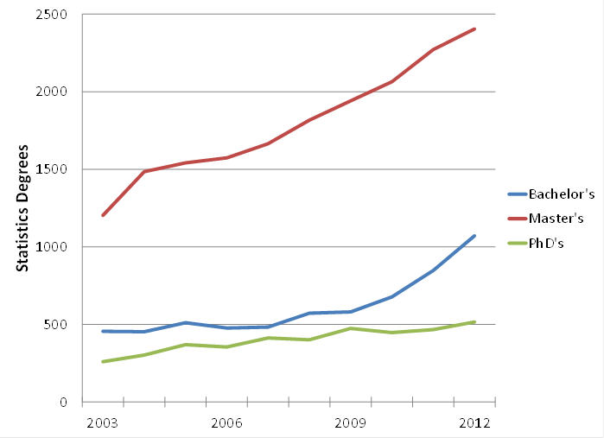
Statistics degrees at the bachelor’s, master’s, and doctoral levels in the United States. These data include the following categories: statistics, general; mathematical statistics and probability; mathematics and statistics; statistics, other; and biostatistics. Data source: NCES Digest of Education Statistics.
Notes:
Bachelor degrees for these combined categories are up 26% over the year before; Master’s are up 6%; and PhD’s are up 10% (mostly because biostatistics PhD’s jumped from 125 in 2011 to 173 in 2012.)

Slide 5
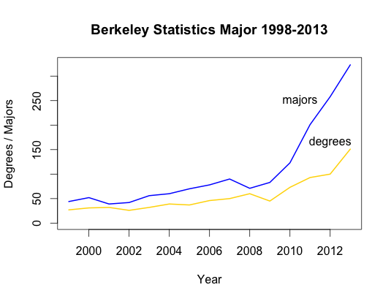

Slide 6
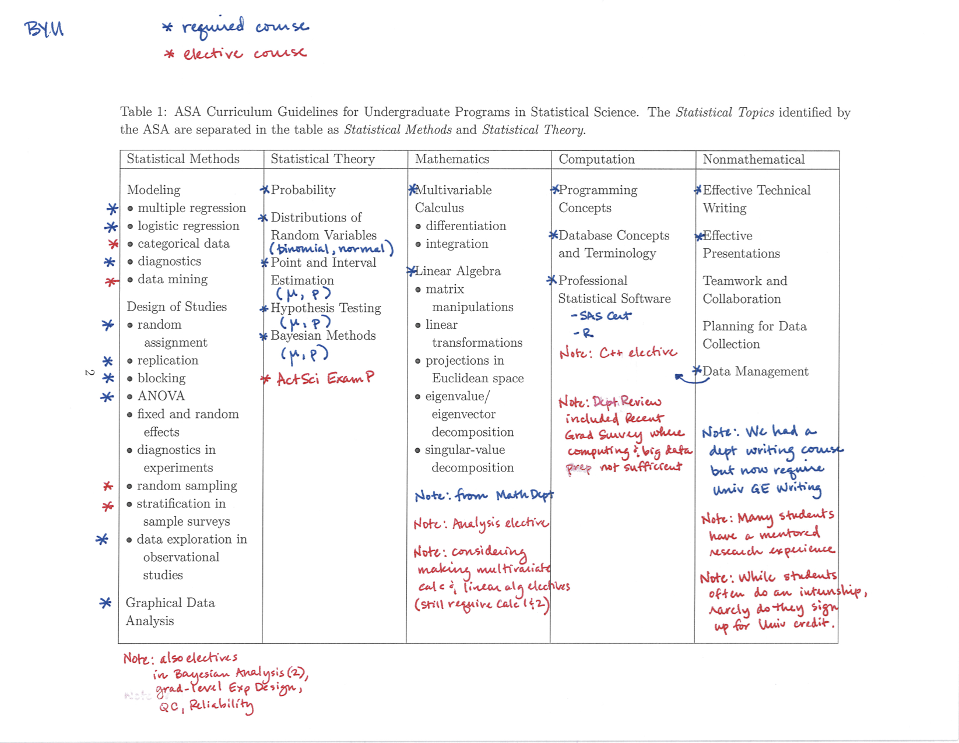

Slide 7
Shortage of mathematical scientists and statisticians in pipeline
Widely quoted McKinsey report: shortage of 140-190k people with analytical expertise and 1.5 million managers with skills to understand and make decisions based on the analysis of big data
NRC 2013 report recommended training of future mathematical and statistical scientists be reassessed in light of increasing breadth and cross-disciplinarity
A special challenge is to retain underprepared and underrepresented groups
Focus of INGenIOuS project (ingeniousmathstat.org, report forthcoming)

Slide 8
Growth in Community Colleges
Nearly 7 million students were enrolled at public two-year colleges in Fall 2010
Enrollment in mathematics and statistics courses in math programs reached a high of 2,104,751 students (CBMS)
21% growth in two year math enrollments from 2005 to 2010 (counting dual enrollees)
26% growth in math enrollments at 4 year institutions during same period

Slide 9
Growth of Statistics in Community Colleges
In 1965, at two-year colleges, there was one section of introductory statistics for every ten sections of calculus
By 1990, the ratio had grown from 1:10 to 1:2
In 2010, the enrollment in statistics courses was estimated at 134,000
Comparable to the enrollment in all calculus classes (131,000 in total in 2010)

Slide 10
Growth of Statistics in Community Colleges
Elementary statistics tied with Math Modeling for highest average section size
Elementary statistics tied for first for largest average distance learning section size
38% of elementary statistics sections taught by part-time faculty (vs 11% for mainstream calculus)

Slide 11
Charge of ASA/AMATYC
Joint Committee
To improve the quality of statistics education in two-year colleges by planning workshops, conference presentations, and other effective forms of professional development for two-year college statistics instructors
To promote consistency and transferability between statistics courses offered at two-year and four-year colleges
To communicate with two and four-year colleges relative to the statistical preparation of elementary and secondary teachers

Slide 12
Charge of ASA/AMATYC
Joint Committee (cont.)
To communicate with K-12 mathematics educators to address the effect of pre-college statistical education on statistics courses taught in two-year colleges.
To ensure ongoing communication between AMATYC and the ASA with the objective of identifying changing trends in undergraduate statistics education.

Slide 13
Charge of AMATYC
Statistics Committee
The role of the AMATYC Statistics Committee:
Provides professional development and support for the teaching and learning of statistics
Fosters the use of the GAISE guidelines, making them relevant to the community college setting
Serves as a liaison with four-year college faculty, other mathematical organizations and professional statistics organizations in order to share resources

Slide 14
Questions for Panel (I)
What can community colleges do to help prepare future statistics majors while at community college?
  What exposure to data analysis should they get in their intro stats course?
  What mathematics courses can they complete in preparation for their major?
  What computing or statistical computing can your students learn in their first two years?

Slide 15
Questions for Panel (II)
There are presently no second statistics courses offered in community colleges. There are a number of reasons for this, including transferability of a second course, challenges in terms of faculty development, and constraints on the growth of programs.
Would it be more useful to consider models for a second course, or instead focus on completing math and CS requirements for a stats major (as well as general education requirements)?

Slide 16
Questions for Panel (III)
What do you feel is lacking in the guidelines and/or accompanying resources in general or specifically relating to community colleges?
  How do we prepare students for jobs at the BA level that involve statistics (but don’t generally have “statistician” in the title?)
  What has changed since 2000?
  What hasn’t changed?

Slide 17
Questions for Panel (IV)
How can there be better integration between undergraduate statistics programs and community colleges?
  How can information about future opportunities in statistics be publicized?
  What questions should the workgroup be asking ASA/AMATYC and AMATYC Statistics Committees?

Slide 18
Discussion
More information about the existing curriculum guidelines as well as a survey can be found at:
http://www.amstat.org/education/curriculumguidelines.cfm

