Slide 1
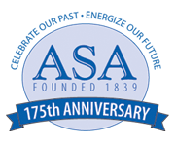
Observations from Large Programs
Guidelines for Undergraduate Statistics Programs Workgroup Webinar Series
September 27, 2013
http://www.amstat.org/education/curriculumguidelines.cfm

Slide 2
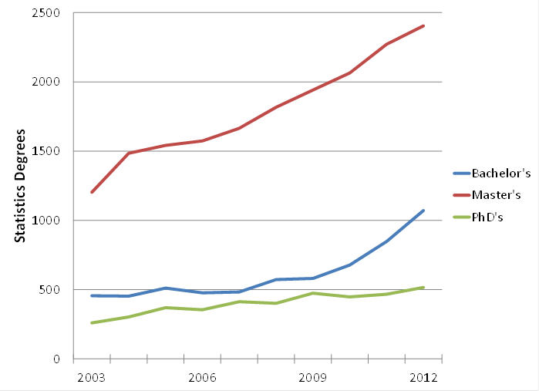
Statistics degrees at the bachelor’s, master’s, and doctoral levels in the United States. These data include the following categories: statistics, general; mathematical statistics and probability; mathematics and statistics; statistics, other; and biostatistics. Data source: NCES Digest of Education Statistics.
Notes:
Bachelor degrees for these combined categories are up 26% over the year before; Master’s are up 6%; and PhD’s are up 10% (mostly because biostatistics PhD’s jumped from 125 in 2011 to 173 in 2012.)

Slide 3
Background
A workgroup was formed in 2013 by ASA President-Elect Nat Schenker to recommend revisions of the ASA’s “Curriculum Guidelines for Undergraduate Programs in Statistical Sciences”
Group was asked to involve a wide range of experts in the discussions about what has changed in the past 13 years, and what changes are warranted given growth in these programs
Diverse set of members from industry, government and academia
Timetable: recommendations by JSM 2014

Slide 4
Workgroup members
Nicholas Horton (Amherst College, chair)
Rebecca Nichols (ASA Education Program Director)
Beth Chance (Cal Poly San Luis Obispo)
Stephen H. Cohen (National Science Foundation)
Scott Grimshaw (Brigham Young University)
Johanna Hardin (Pomona College)
Tim Hesterberg (Google)
Roger Hoerl (Union College)
Lisa LaVange (Food and Drug Administration)
Chris Malone (Winona State University)
Deborah Nolan (University of California, Berkeley)
(affiliations listed only for identification purposes)

Slide 5
Upcoming webinars
Connection with Community Colleges (Monday, October 21st, 6:00-6:45pm ET)
Building towards Big Data and Data Science (Monday, November 18th, 6:00-6:45pm ET)
The Role of Undergraduate Capstone Courses (Wednesday, December 4th, 5:00-5:45pm ET)
Suggestions for other topics welcomed!

Slide 6
Observations from Large Programs
Guidelines for Undergraduate Statistics Programs Workgroup Webinar Series
David Harrington, Harvard
Scott Grimshaw, BYU
Deborah Nolan, Berkeley
Roger Woodard, NCSU

Slide 7
Plan
Different institutions implement statistics programs in different ways. In this webinar, we will hear from representatives from four large and diverse undergraduate statistics programs (Berkeley, BYU, Harvard and NCSU), discuss the existing guidelines and raise issues which should be addressed in the future.

Slide 8
Schedule
Introduction
Brief descriptions of program
Questions for panel
Open discussion

Slide 9
Harvard Undergraduate Statistics Program
Undergraduate degree started in 1964
Currently 13 FTE ladder and teaching faculty
3 open faculty positions
Approximately 125 Statistics majors
Does not include students minoring in Statistics
39 Seniors this year

Slide 11

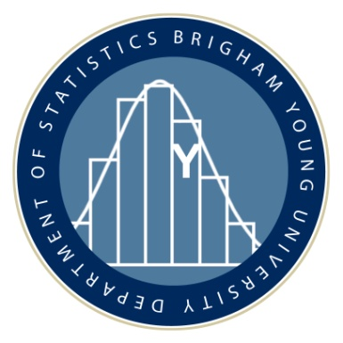
Brigham Young University
33,000 total students (30,000 undergrads)
Statistics Major Created in 1960 (5 students)
First BS Statistics awarded in 1961
(before MS Statistics program approved)
63 graduated in 2013 (Statistics & ActSci)
288 majors in Fall 2013

Slide 12
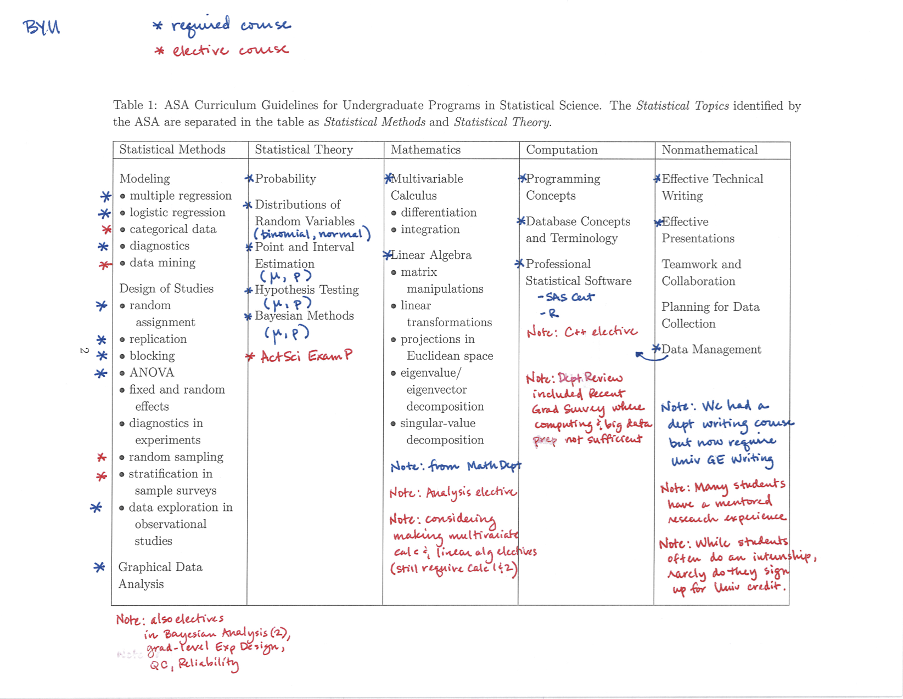

Slide 13
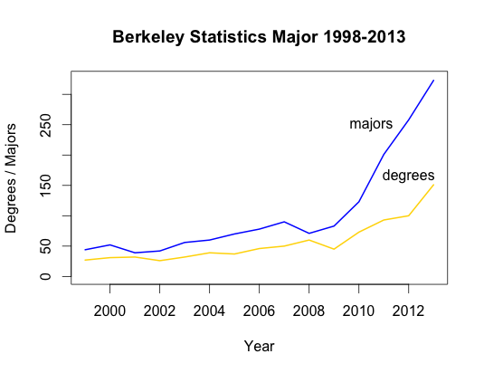

Slide 14
Berkeley Statistics Major
Prerequisites – calculus (multivariate), linear algebra
3 CORE courses: Concepts in Probability, Statistics, Computing with Data
3 Statistics Electives, e.g., time series, linear models, stochastic processes
3 course concentration - grad school bound are advised to take 3 math courses, others choose 3 quantitative courses in an area in which statistics is applied

Slide 15
NC State University
NC State University has about 30,000 students
Department of Statistics
Oldest and one of the largest in the country
First undergraduate in 1947
45 faculty
120 undergraduates
28 graduating this year

Slide 16
NC State Core components
Calculus, linear algebra, computer sci.,
Communications
Intro. Methods
Math Stat I and II
Regression, Design, Sampling, quality control
Statistical Computing
Elective course: non-parametrics, survival, Bayesian methods, actuarial, environmental,…

Slide 17
Questions for Panel (1)
How do you use the guidelines? What adaptations or creative solutions have you used?
For example, how do you develop majors’ nonmathematical skills?
How are you including depth in a substantive area?
What statistical computing do your students learn?

Slide 18
Questions for Panel (2)
What do you feel is lacking in the guidelines and/or accompanying resources?
E.g., should more be done with “data issues” before analysis? Non-traditional data? Where do students learn data visualization skills? Where do students see “big data”? Do students take computing courses from other departments/how does that work?
What skills/topics do you think need to be added to the guidelines? Are there any that could be deleted?

Slide 19
Questions for Panel (3)
How can we evaluate the effectiveness of our programs?
What measures of quality have been used? Can they be improved?
What is the dividing line between a bachelor’s degree and a master’s degree?
What types of careers can BS students find?
Can we improve student preparation for life after graduation?

Slide 20
Questions for Panel (4)
How are you handling the growth in the major and the statistics courses?
Are you making more branches/tracks in the major, eg., traditional vs. data science?
Do you differentiate students going to graduate school vs. industry?

Slide 21
Open Discussion
Please send your questions via the chat feature, or unmute your phone and ask it directly
More information about the existing curriculum guidelines as well as a survey can be found at:
http://www.amstat.org/education/curriculumguidelines.cfm
This webinar (and the others to follow) will be posted here

