Slide 1


The Role and Variety of Undergraduate Statistics Capstones
Guidelines for Undergraduate Statistics Programs
Workgroup Webinar Series
December 4, 2013
http://www.amstat.org/education/curriculumguidelines.cfm

Slide 2
Background
A workgroup was recently formed by ASA President-Elect Nat Schenker to recommend revisions of the ASA’s “Curriculum Guidelines for Undergraduate Programs in Statistical Sciences” from 2000.
This Workgroup Webinar Series is being used to involve a wide range of experts in the discussions about what has changed in the past 13 years, and what changes are warranted given recent growth in our discipline
Initial recommendations are due at JSM 2014

Slide 3
Members of Workgroup
Nicholas Horton (Amherst College, chair)
Rebecca Nichols (ASA Education Program Director)
Beth Chance (Cal Poly San Luis Obispo)
Stephen H. Cohen (National Science Foundation)
Scott Grimshaw (Brigham Young University)
Johanna Hardin (Pomona College)
Tim Hesterberg (Google)
Roger Hoerl (Union College)
Lisa LaVange (Food and Drug Administration)
Chris Malone (Winona State University)
Deborah Nolan (University of California, Berkeley)
… I apologize if I missed anybody

Slide 4
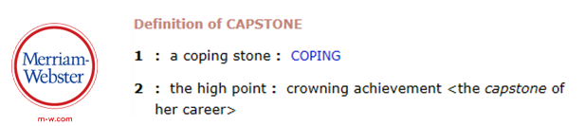
The Role and Variety of Undergraduate Statistics Capstones
Guidelines for Undergraduate Statistics Programs
Workgroup Webinar Series
December 4, 2013

Slide 5





Introductions
  Moderator: Chris Malone (cmalone@winona.edu)
  Panelist:
    Danny Kaplan (kaplan@macalester.edu)
    Nicole Lazar nlazar@stat.uga.edu)
    Rebecca Nugent rnugent@stat.cmu.edu)
    Dalene Stangl (dalene@stat.duke.edu )

Slide 6

Schedule
    Description of each school’s capstone-type experience
    Q1: Balance between number of capstones vs. ensuring each individual student reaches their potential to learn independently
    Q2: Resources necessary for student and faculty
    Q3: How is the work disseminated?

Slide 7
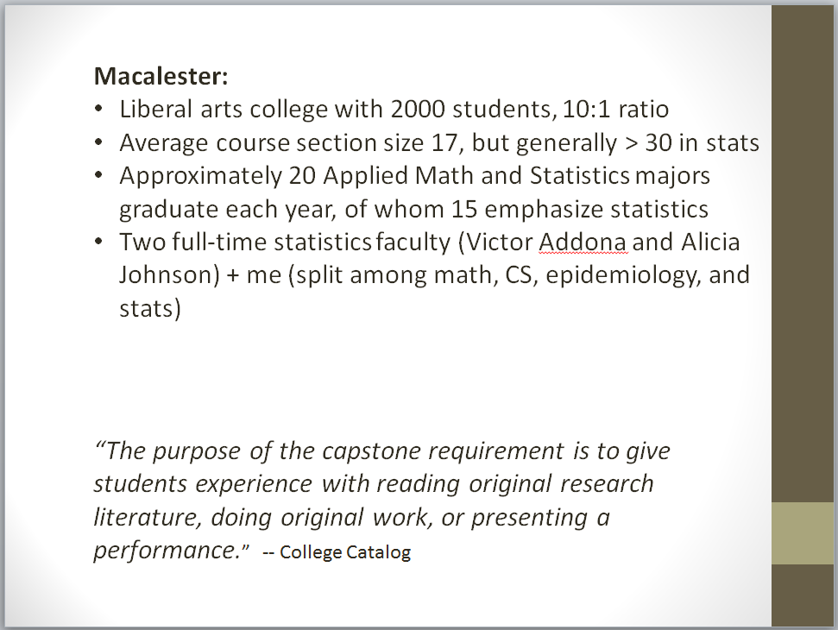

Slide 8
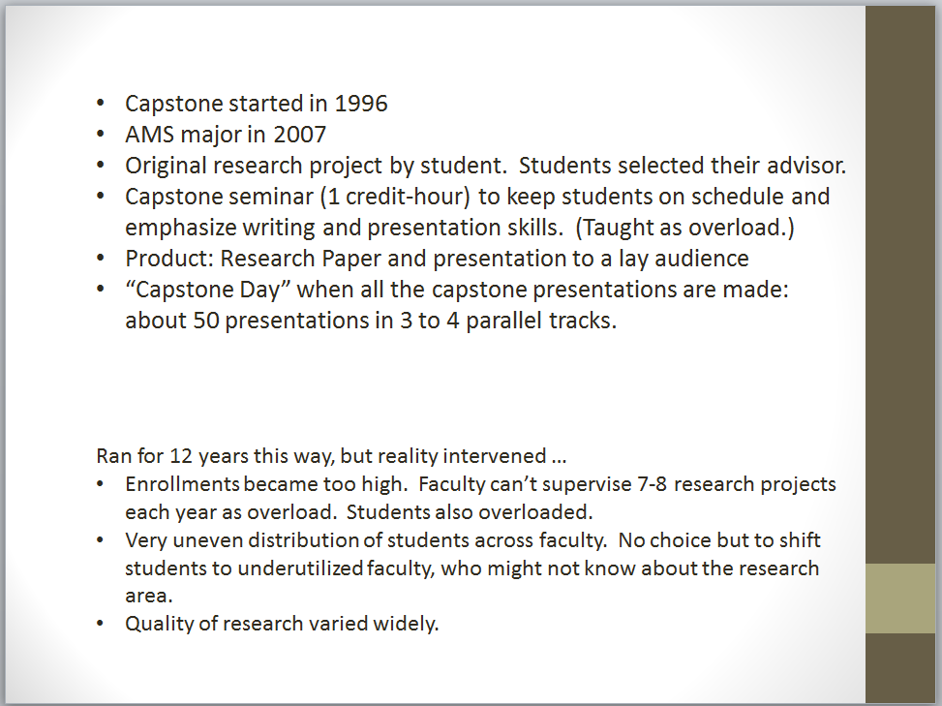

Slide 9
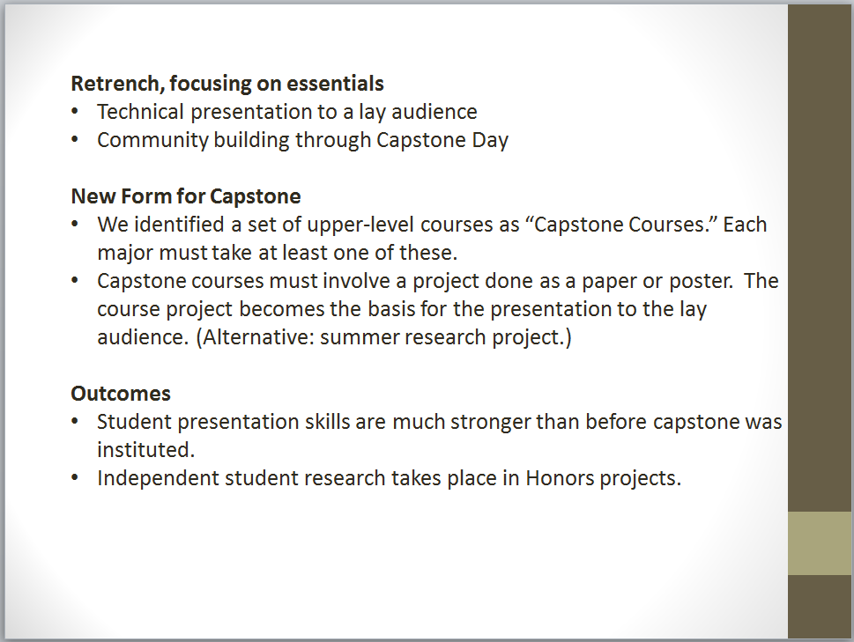

Slide 10
Projects are gathered mostly from researchers on campus.
Projects are “low stakes” from the perspective of the researcher.
Sometimes get projects from off campus (CDC, USDA).
Some years we also have a larger, “service” project.

Slide 11
“Service” projects involve study design, data collection, and analysis.
Entire class participates.
Example: Nuci's Space (local non-profit) study of health insurance needs of Athens GA musicians.
Example: Survey of campus and municipal bus ridership for Campus Transit Authority.

Slide 12
Course is yearlong, writing intensive.
Required for all undergraduate Statistics majors.
Some minors also take.
First year (AY 2007-2008): 10 students.
Currently: 20+ students.

Slide 13
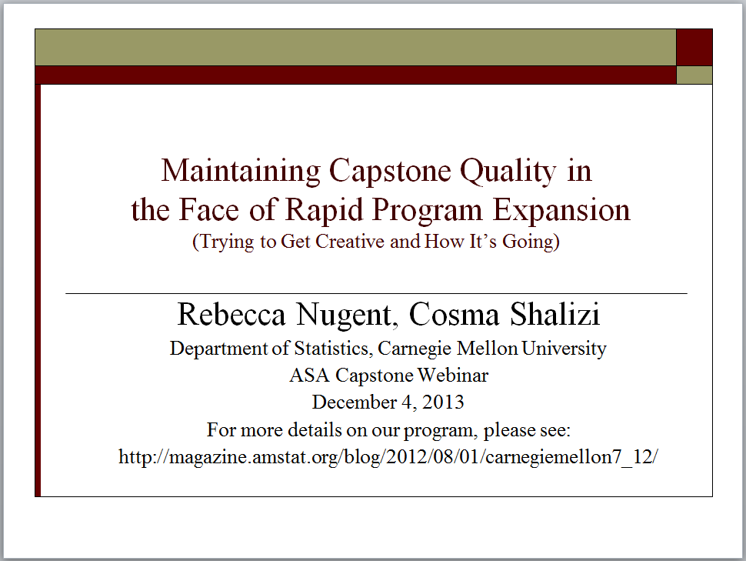

Slide 14
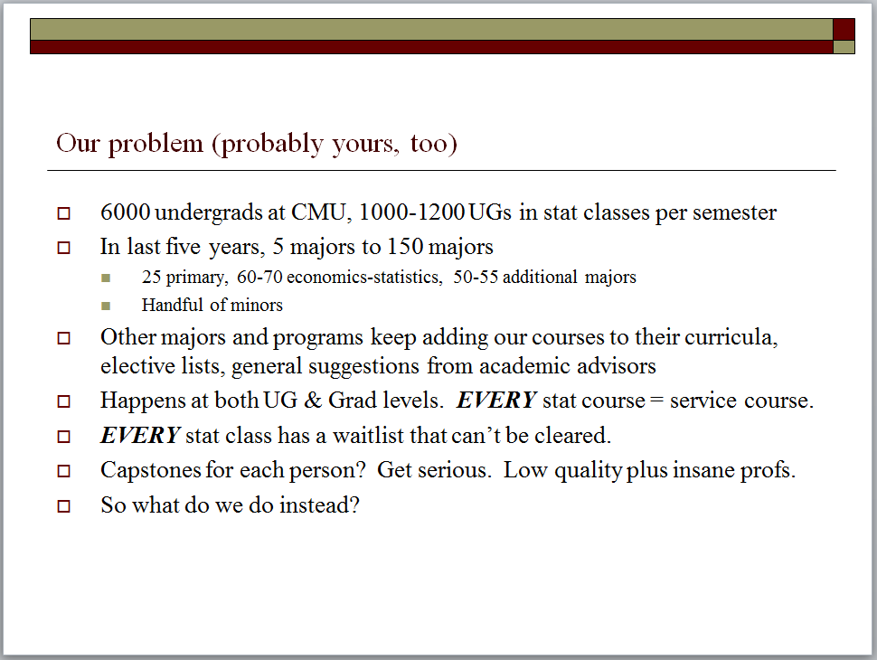

Slide 15
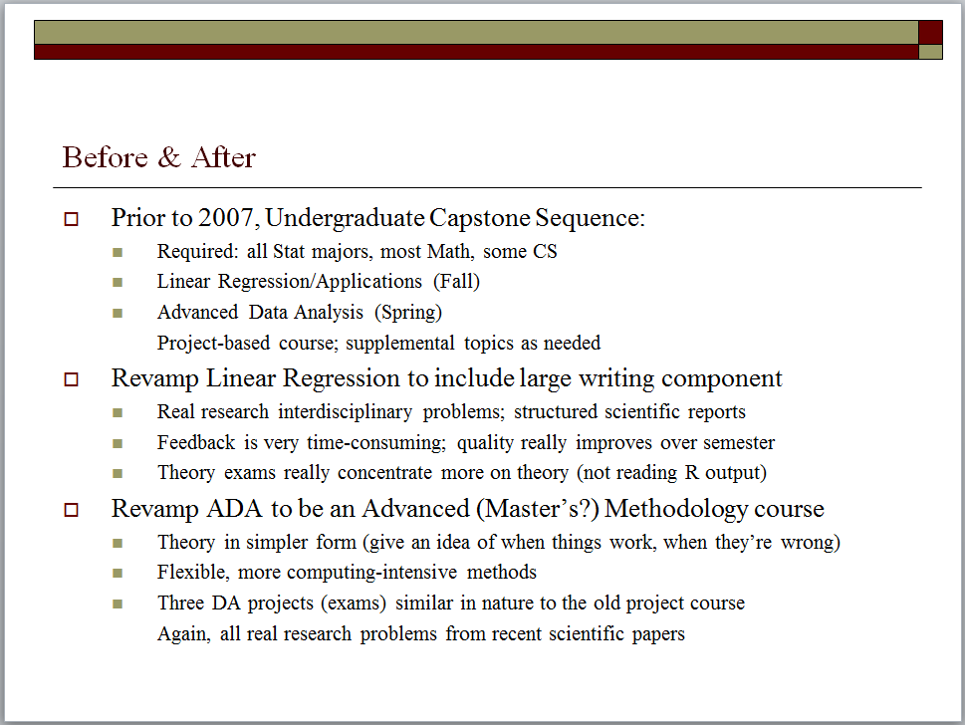

Slide 16
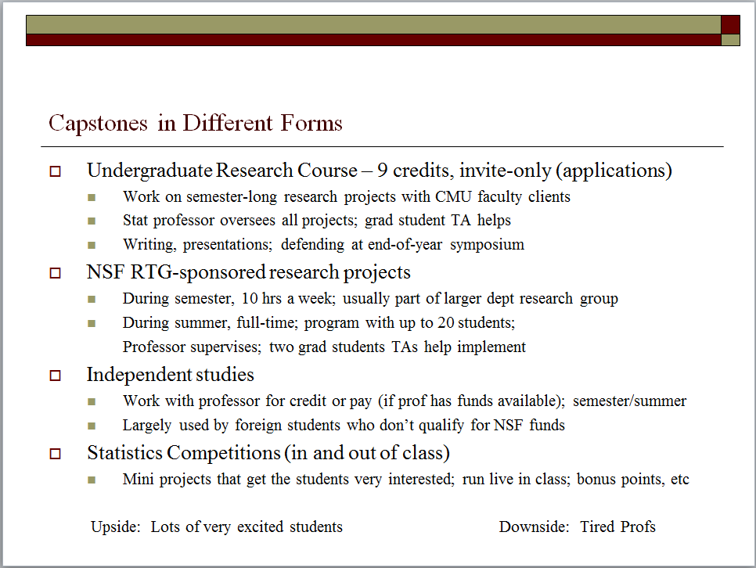

Slide 17
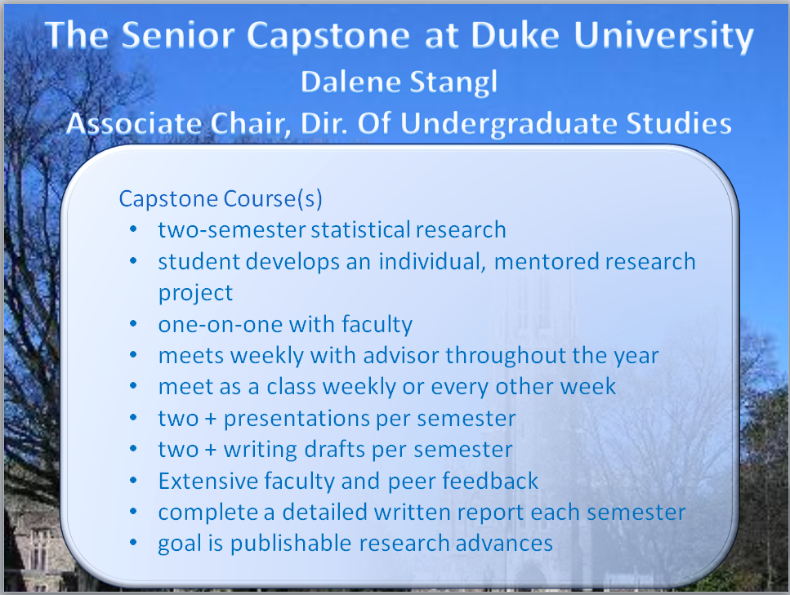

Slide 18
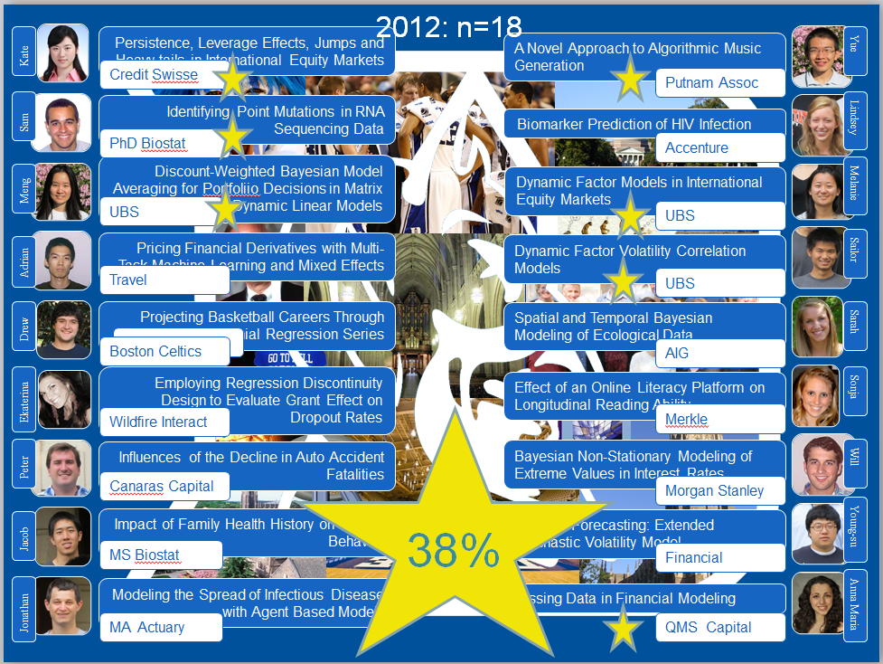

Slide 19
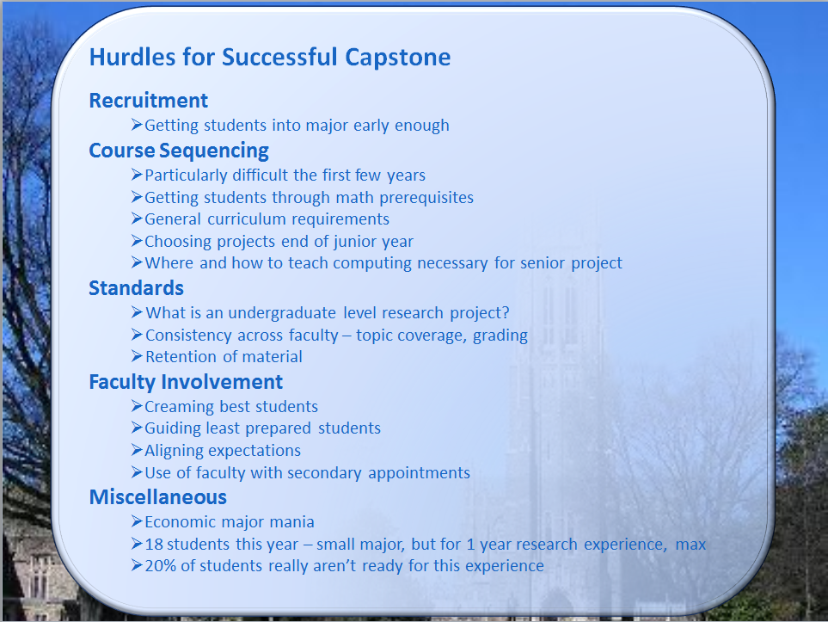

Slide 20

Questions
  Q1: Balance between number of capstones vs. ensuring each individual student reaches their potential to learn independently
  Question?
  Use the chat feature and/or ask to be unmuted

Slide 21
Questions
  Q1: Balance between number of capstones vs. ensuring each individual student reaches their potential to learn independently
  Q2: Resources necessary for student and faculty
  Question?
  Use the chat feature and/or ask to be unmuted

Slide 22
Questions
  Q1: Balance between number of capstones vs. ensuring each individual student reaches their potential to learn independently
  Q2: Resources necessary for student and faculty
  Q3: How is the work disseminated?
  Question?
  Use the chat feature and/or ask to be unmuted

Slide 23
Thank you for attending
The Role and Variety of Undergraduate Statistics Capstones
Guidelines for Undergraduate Statistics Programs
Workgroup Webinar Series
http://www.amstat.org/education/curriculumguidelines.cfm

