Slide 1
Preparing Statistics Majors for Graduate Study
(Perhaps Your Own!)
ASA Working Group to Revise the Undergraduate Statistics Curriculum
Winter 2013

Slide 2
Outline
Introduction of Invited Participants
  Sandy Weisberg, Univ of Minnesota
  Jane Monaco, UNC Biostatistics
  Simon Sheather, Texas A&M
  Mark Ward, Purdue
Questions for Panel
Open Discussion

Slide 3
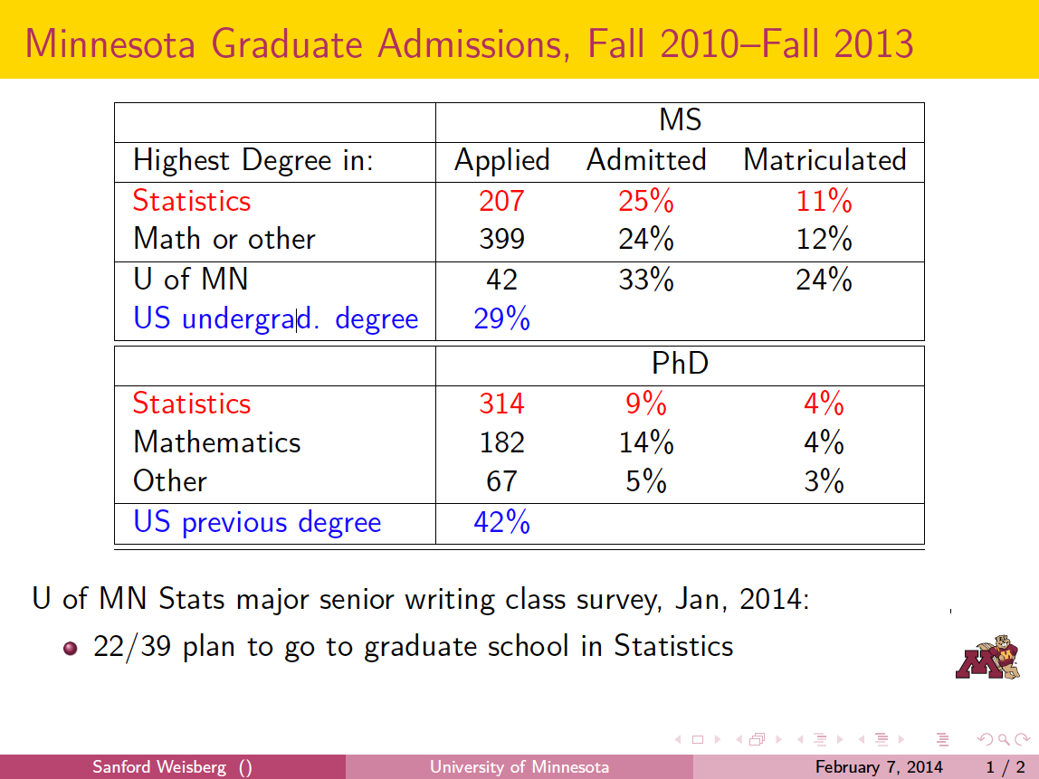

Slide 4
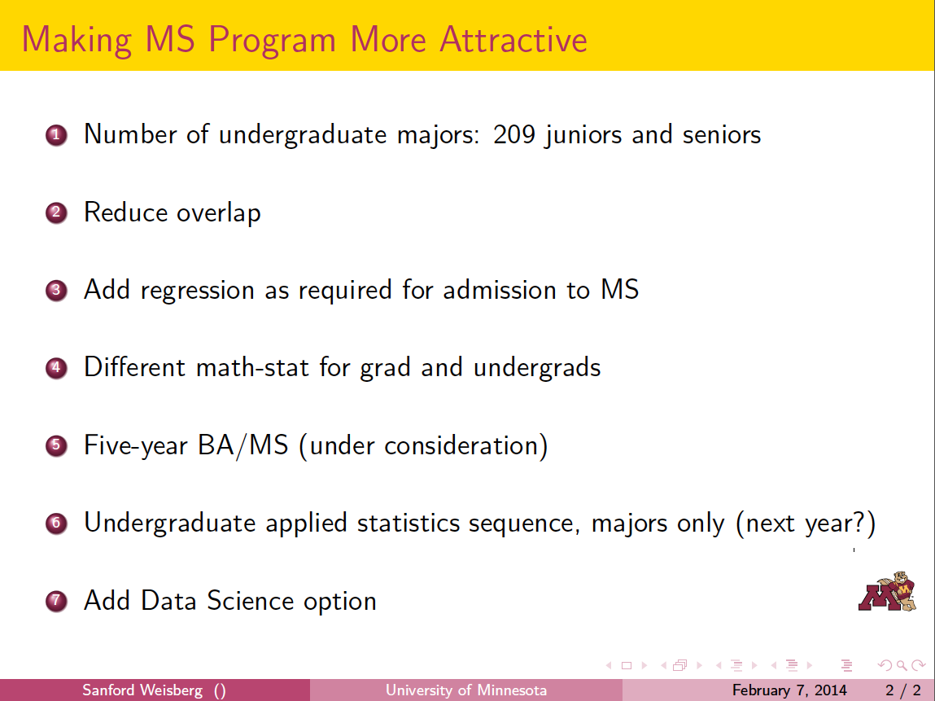

Slide 5

UNC-CH Dept Biostatistics Admissions by Major
(2013)
Masters Degrees: MPH/MS | # Applied | # Accepted (% Accepted) | # Matriculated
Our BSPH Bios Majors | 2 | 1 (50%) | 0
Other Stat Majors | 35 | 7 (20%) | 3
Math Majors | 21 | 9 (43%) | 5
Other Majors | 100 | 19 (19%) | 10
TOTAL | 158 | 36 (23%) | 18
Doctoral Degrees: DrPH/PhD | # Applied | # Accepted (% Accepted) | # Matriculated
Our BSPH Bios Majors | 3 | 3 (100%) | 1
Other Stat Majors | 56 | 9 (16%) | 4
Math Majors | 58 | 26 (45%) | 11
Other Majors | 63 | 3 (5%) | 1
TOTAL | 180 | 41 (23%) | 17

Slide 6
UNC-CH Department of Biostatistics
BSPH in Biostatistics
  Accept ~ 15 BSPH Biostat Students per year (apply in soph. year)
  Average GPA = 3.6 Average Math SAT = 710/800 (94th%)
Curriculum Highlights:
Great things they do! Senior honors projects, internships, double majors,….
First destinations: 35% Grad School in Biostat, 30% Employed in Biostat-related job, 25% Medical School
Math | Biostatistics | Other
Calculus (3 semesters), Linear Algebra, Discrete Math, Real Analysis,…. | Applied Biostat Methods, SAS Programming, Linear Models, Inference, Survey Sampling, Design PH Trials. | Public Health Core (Epid, Environmental Science, Health Policy, Health Behavior) and Genetics.

Slide 7
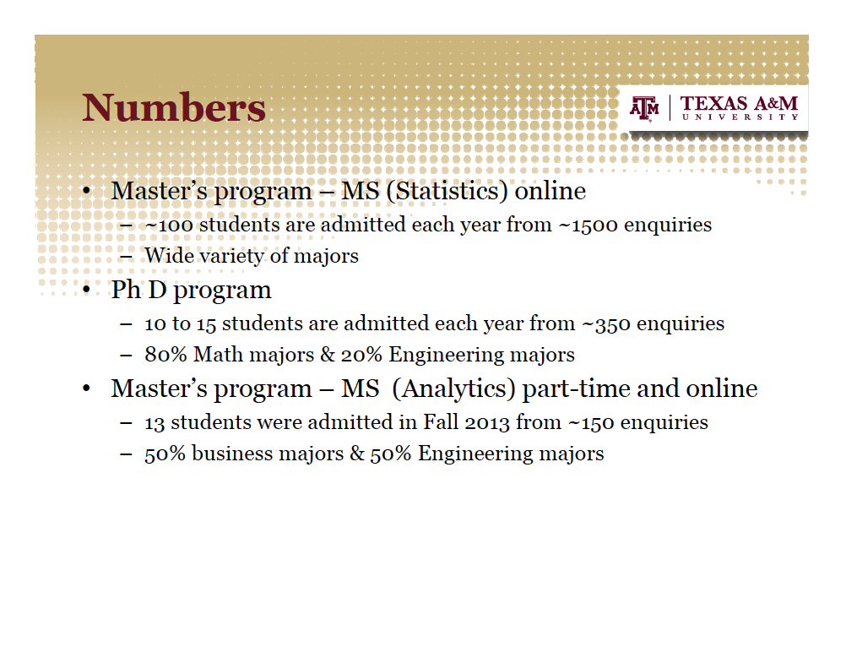

Slide 8
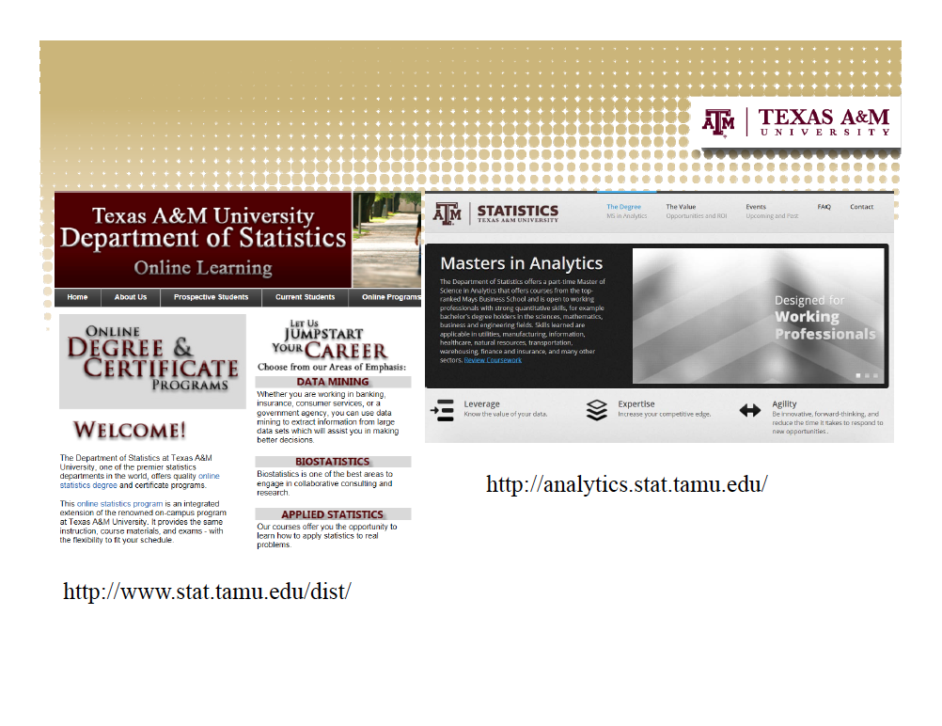

Slide 9
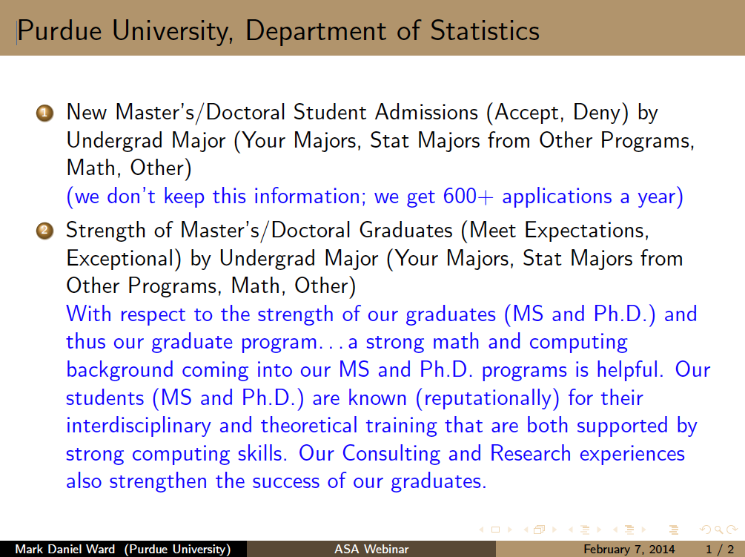

Slide 10
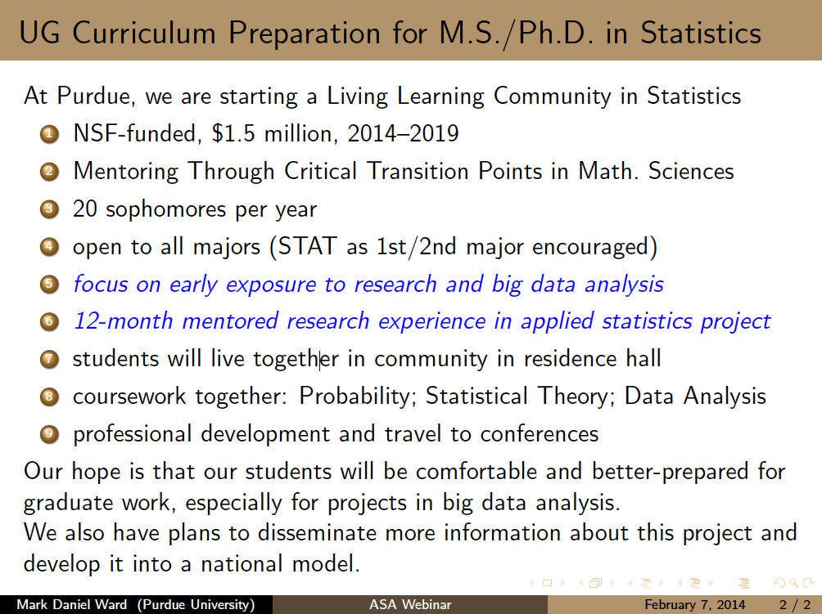

Slide 11
What Topics Make Statistics Majors Successful Applicants?
Statistical Topics
Statistical theory (e.g., distributions of random variables, point and interval estimation, hypothesis testing, Bayesian methods)
Graphical data analysis methods
Statistical modeling (e.g., simple, multiple, and logistic regression; categorical data; diagnostics; data mining)
Design of studies (e.g., random assignment, replication, blocking, analysis of variance, fixed and random effects, diagnostics in experiments; random sampling, stratification in sample surveys; data exploration in observational studies)
Mathematical Topics
Calculus (integration and differentiation) through multivariable calculus
Applied linear algebra (emphasis on matrix manipulations, linear transformations, projections in Euclidean space, eigenvalue/eigenvector decomposition and singular-value decomposition)
Probability
Emphasis on connections between concepts and their applications in statistics
Computational Topics
Programming concepts; database concepts and technology
Professional statistical software appropriate for a variety of tasks
Nonmathematical Topics
Effective technical writing and presentations
Teamwork and collaboration
Planning for data collection
Data management
Additions to Current Guidelines:

Slide 12
What Should be Added to Undergraduate Preparation?
Additional Depth in Current Topics:
Additional Topics:

Slide 13
Responding to the Demand for Statisticians:
Sheather:
What are some of the programs (degrees and certificates) created by A&M to respond to the high demand for statisticians?
Are statistics majors better prepared for MS Statistics or MS Analytics program (or neither)?

Slide 14
Focusing on Biostatistics:
Monaco:
The typical recruit for a biostatistics program is not a statistics major.
Share how and when your BS/MS Integrated Biostatistics program covers topics in statistics, computing, and mathematics.

Slide 15
Difference Between Undergraduate and Graduate Expectations
Weisberg & Sheather:
Examples of Undergraduate Regression Topics
Examples of Graduate Regression Topics

Slide 16
Preparation and Performance of Your Majors Who Have Gone Elsewhere
Ward
Monaco
Weisberg

Slide 17
Looking Forward: Big Data and Computing
Skills Needed:
Skills of Stronger Candidates:

Slide 18
Discussion
More information about the existing curriculum guidelines as well as a survey to share your thoughts:
http://www.amstat.org/education/curriculumguidelines.cfm

