Slide 1
GAISEing into the Common Core Statistics Standards
A Chapter's Grassroots Approach to Preparing Teachers

Slide 2

Presenters:
Dr. Stephanie Casey, Assistant Professor of Mathematics Education at
Eastern Michigan University
Karen Nielsen, Ph.D. student,
Department of Statistics at the University of Michigan

Slide 3

Overview of Webinar
Story of our chapter’s journey to help prepare local inservice teachers to teach the statistics standards in the CCSS-M
Keys to success
Activities we used with teachers
Q&A

Slide 4
Inservice Teachers’ Need for PD
Substantially increased status of statistics in the CCSS-M
All teachers (not just AP Statistics teachers) will be teaching statistics
Easier issue to address with preservice teachers
Great need for professional development for inservice teachers
Large number of districts in MI in financial crisis → no money to devote to PD

Slide 5
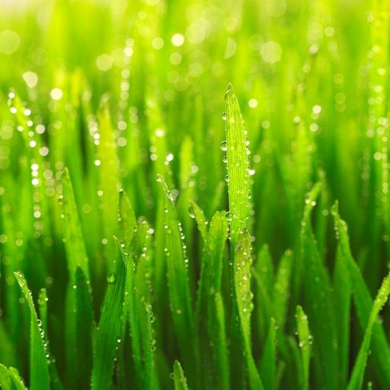
Grassroots approach
ASA Ann Arbor Chapter (President Anamaria Kazanis) partnered with
Statistics educators in the area
Eastern Michigan professors Stephanie Casey & Andrew Ross
University of Michigan senior lecturer Brenda Gunderson
University of Michigan statistics graduate students Karen Nielsen & Mackenzie Fankell
Ann Arbor Public Schools district
Mathematics coordinator
AP Statistics teachers
Mathematics teachers
Notes:
Learn from math coordinator & AP stats teachers their needs
Demonstrate stats educators’ knowledgable and there to help

Slide 6
Summer Seminar
GAISEing into the Statistics Common Core
June 26-28, 2013
GAISE statistical investigation process
GAISE teaching recommendations
Organized by CCSS-M learning trajectories
Classroom-ready engaging and cognitively demanding activities
Mix of content and pedagogy
Attended by 32 grade 6-12 mathematics teachers

Slide 7

Keys to successful recruitment of teachers
FREE!
Held immediately after school ended
State continuing education clock hours
Encouraged to attend by school district’s mathematics coordinator
Established relationship with local district
Advertising

Slide 8
GAISEing into the Common Core Standards – Day 1
A Professional Development Seminar sponsored by the Ann Arbor Chapter of the ASA
Notes:
I think your Day 1 slides are a good set (1 – 11)

Slide 9
How it worked: lots of activities!
A typical arc consisted of:
a statement of the common core standards to be addressed
a fun activity, worksheet, example, or conversation-starter
questions about the statistical concepts
time to debrief - what worked, what didn’t, what is surprising, what questions from students to anticipate, how might you modify it…
Here are some examples. Feel free to chime in with questions or comments!

Slide 10
The Core
Summarize and describe distributions. | Summarize, represent, and interpret data on a single count or measurement variable
CCSS.Math.Content.6.SP.B.4 Display numerical data in plots on a number line, including dot plots, histograms, and box plots. | CCSS.Math.Content.HSS-ID.A.1 Represent data with plots on the real number line (dot plots, histograms, and box plots).
CCSS.Math.Content.6.SP.B.5 Summarize numerical data sets in relation to their context, such as by:
CCSS.Math.Content.6.SP.B.5a Reporting the number of observations.
CCSS.Math.Content.6.SP.B.5b Describing the nature of the attribute under investigation, including how it was measured and its units of measurement.
CCSS.Math.Content.6.SP.B.5c Giving quantitative measures of center (median and/or mean) and variability (interquartile range and/or mean absolute deviation), as well as describing any overall pattern and any striking deviations from the overall pattern with reference to the context in which the data were gathered. | CCSS.Math.Content.HSS-ID.A.2 Use statistics appropriate to the shape of the data distribution to compare center (median, mean) and spread (interquartile range, standard deviation) of two or more different data sets.
CCSS.Math.Content.6.SP.B.5d Relating the choice of measures of center and variability to the shape of the data distribution and the context in which the data were gathered. | CCSS.Math.Content.HSS-ID.A.3 Interpret differences in shape, center, and spread in the context of the data sets, accounting for possible effects of extreme data points (outliers).
Notes:
Here’s the first set of core standards that we addressed. It includes graphs and informal descriptive statistics. Lots of content is here, but it’s basic for most math and stat teachers, so we came up with a fun way to talk about all of these standards in one activity…

Slide 11
Getting to Know You … Let’s Collect Some Data!
Go around the room and enter data for yourself on the charts.
Men: blue markers
Women: red markers
Height (in)
Number of letters in your first name
Number of siblings (not including yourself)
Favorite color
Do you currently have a dog?
How many pets do you currently have?
Travel time to this workshop? (min)
How many years have you been teaching?
Notes:
Graphing data about ourselves! Students love to work with data that they can relate to or feel personally involved in - this is a theme that we kept throughout the workshop.
We asked everyone to answer questions about themselves by placing an X on the graph. By asking men and women to use different markers, we also gathered data for two groups - descriptive stats and inference for two groups was a later common core standard that we covered.
We asked about different KINDS of variables - categorical and quantitative, continuous and discrete, variables that we anticipated outliers in...

Slide 12
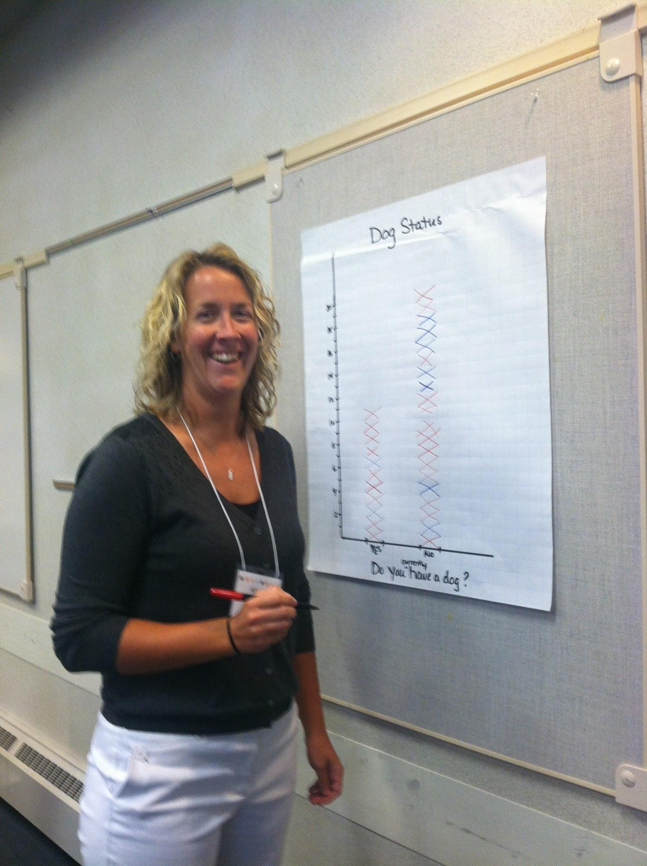
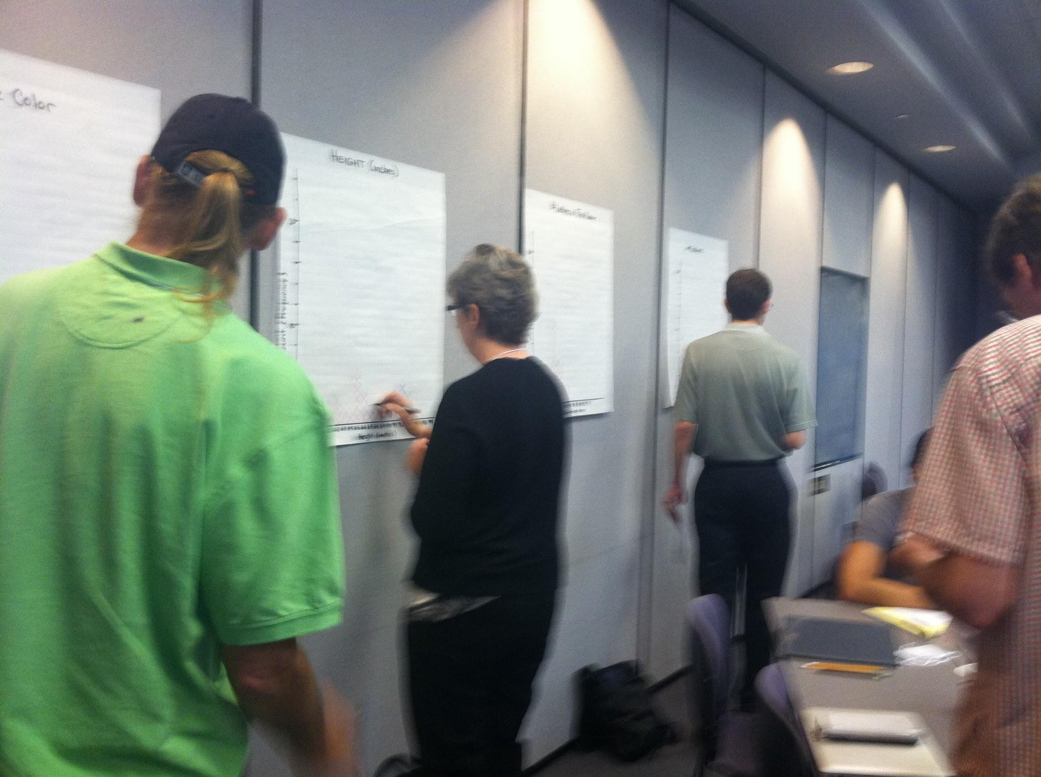
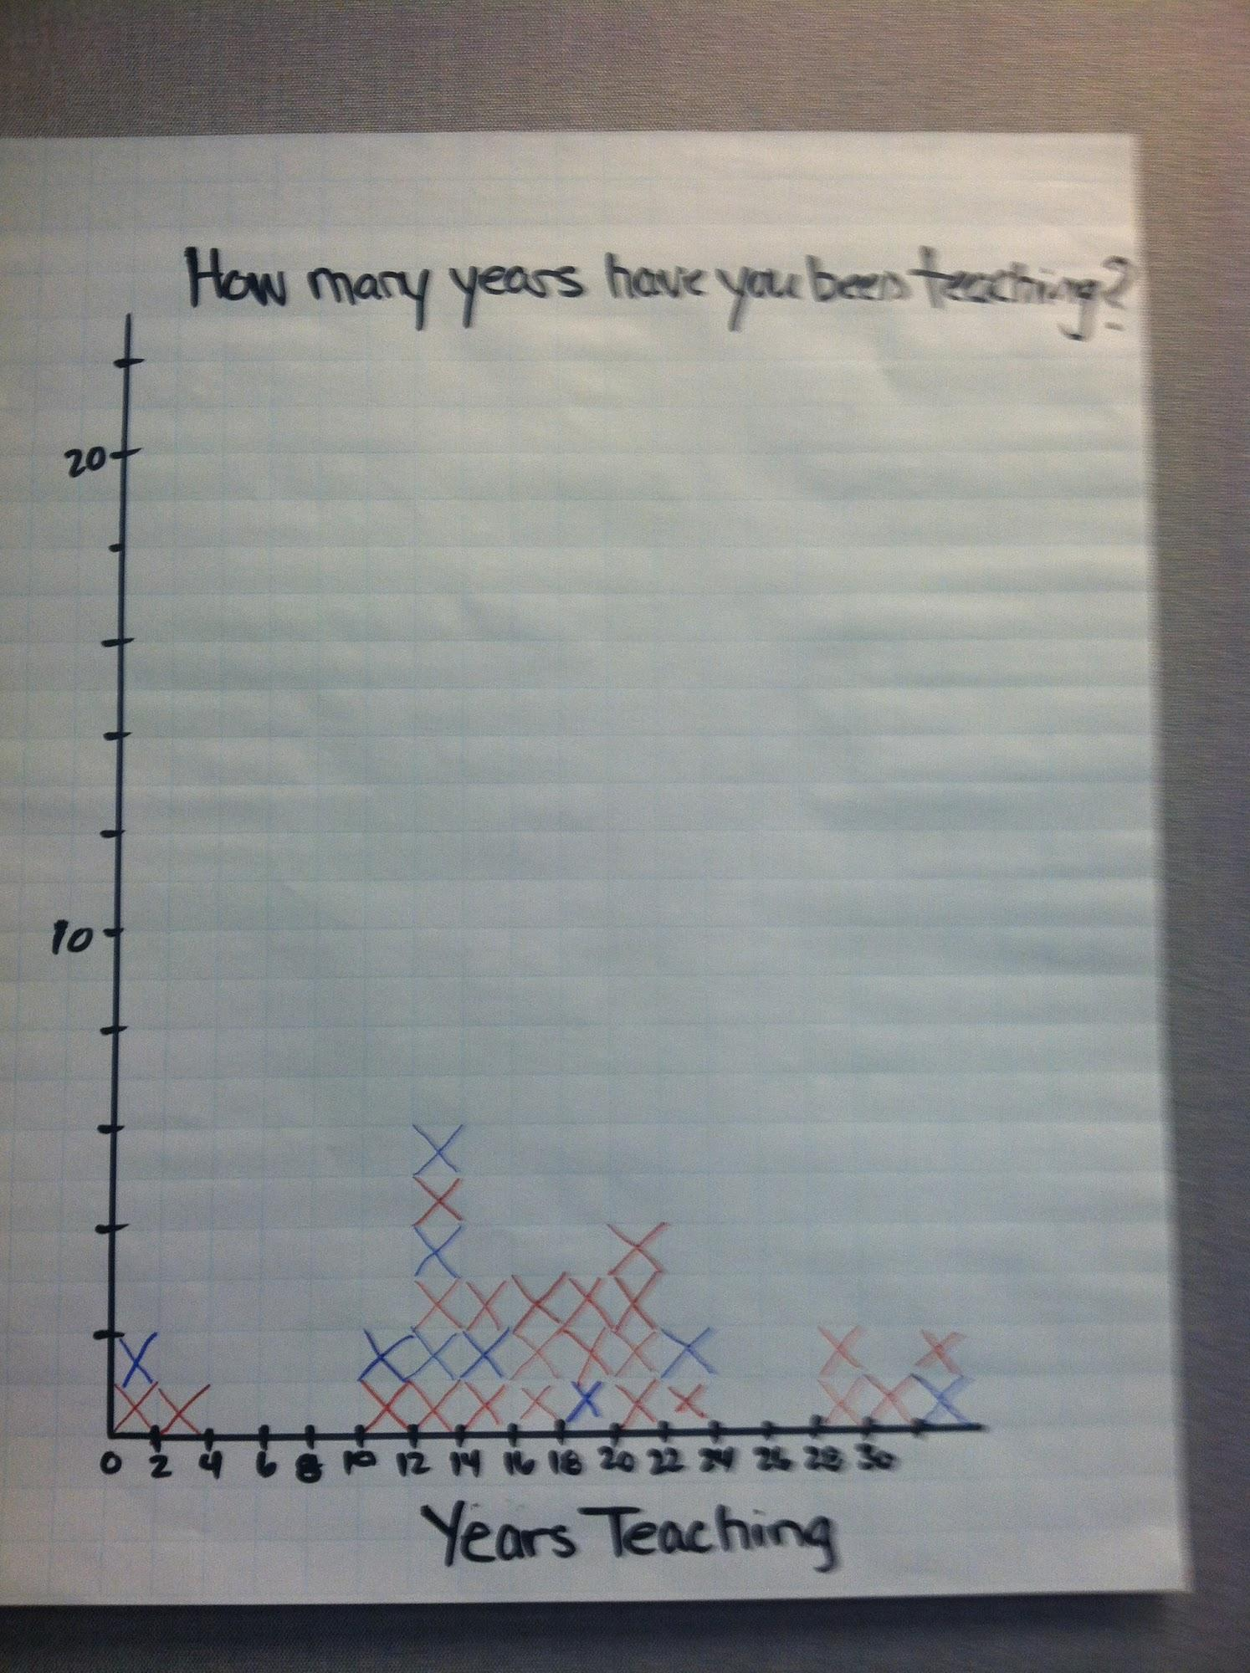
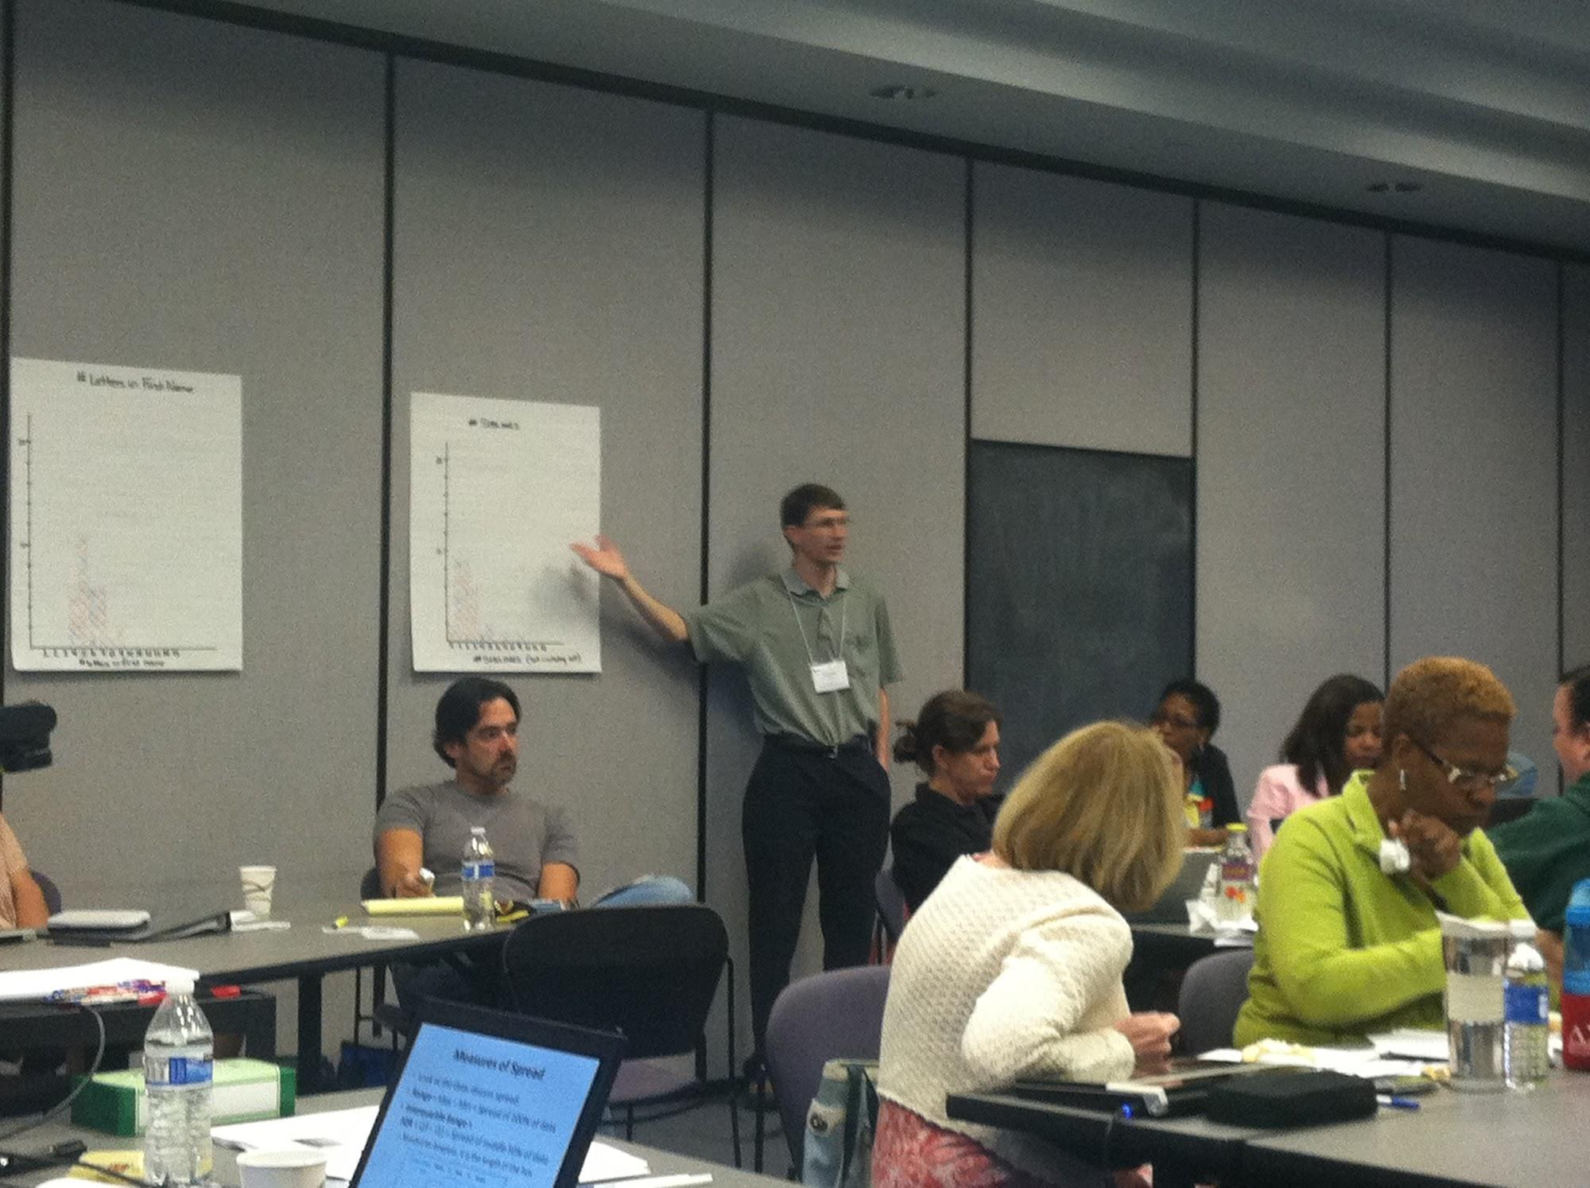

Slide 13
Let’s think about our data
What are the different types of variables that we measured?
How did you measure each of the variables?
Were any of these hard to measure?
What were the units for each variable?
What might the context be for each of these charts?
Notes:
Then we talked about the variables and the results in ways that captured many of the core standards. We also asked for volunteers to present each graph to the group.

Slide 14
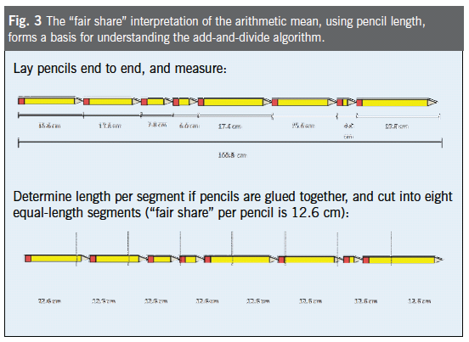
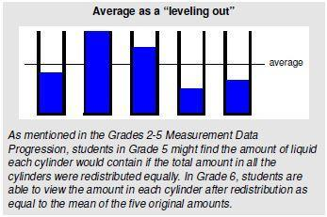
Measures of Center
Mean:
Add and divide
“fair share”
Pencil activity
Block activity
Glass/beaker activity
Notes:
We also presented example activities that we didn’t do, such as these demonstrations of what the mean is. They were selected as additional ways to present the same concept - because it’s always handy to have multiple ways to explain a concept!

Slide 15
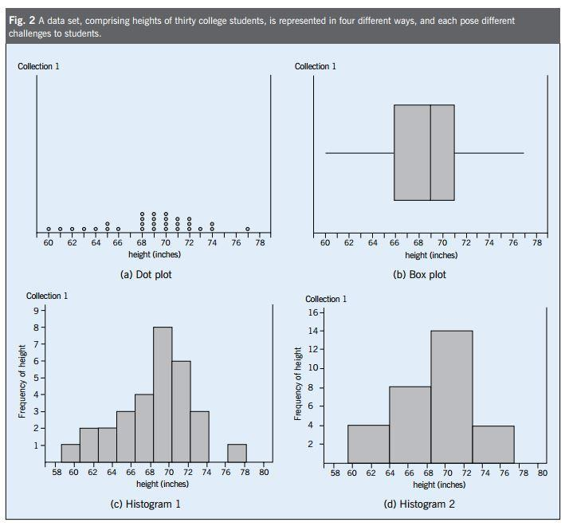
Different Graphs, Same Data
Notes:
We also wanted to provide instructors with ways to construct examples and counter-examples to address common student questions. Here, we can talk about why bin size matters in histograms, how box plots don’t show shape, and how histogram bins can hide exact observations that can be seen in a dot plot.

Slide 16
Back to the Core
Draw informal comparative inferences about two populations.
CCSS.Math.Content.7.SP.B.3 Informally assess the degree of visual overlap of two numerical data distributions with similar variabilities, measuring the difference between the centers by expressing it as a multiple of a measure of variability. For example, the mean height of players on the basketball team is 10 cm greater than the mean height of players on the soccer team, about twice the variability (mean absolute deviation) on either team; on a dot plot, the separation between the two distributions of heights is noticeable.
CCSS.Math.Content.7.SP.B.4 Use measures of center and measures of variability for numerical data from random samples to draw informal comparative inferences about two populations. For example, decide whether the words in a chapter of a seventh-grade science book are generally longer than the words in a chapter of a fourth-grade science book.
CCSS.Math.Content.HSS-IC.B.5 Use data from a randomized experiment to compare two treatments; use simulations to decide if differences between parameters are significant.
Notes:
We would again return to the core...

Slide 17

Are you a Good Timer?
Quick Experiment:
Close your eyes
When you hear the “START”, begin counting off seconds in your head
When you hear the “STOP”, write down the number you reached
Notes:
And then another fun, quick experiment:
Ask everyone to close their eyes and try to count off seconds in their head (1-mississippi, 2-mississipi, etc) while you run a timer for exactly XXX seconds. Then everyone reports how high they had counted by the time the buzzer sounded.
Plot the data – can you guess what was the exact XXX seconds? Could use it to compare results for caffeinated people vs. non-caf., etx. Could then repeat it and see if people get more accurate the 2nd time.

Slide 18
Are you a Good Timer?
Come up and Graph the results
What do we see?
Can you guess the exact number of seconds? How?
How else might we explore this data?
What would be some interesting comparisons to make?
Notes:
Plot the data – can you guess what was the exact XXX seconds?
Would you be comfortable estimating the actual time?
Tell them the actual time (draw it on graph)
This revealed that informal inference was fairly natural to do once a graph was presented - “Oh, most observations are clustered around 21 seconds, so that must be right, even though I counted to 28…”
But we still have some preconceived notions that stand in the way: “They wouldn’t choose 21 seconds, because that’s not a nice, “round” number,” or “I counted to 28 and I really think I’m right, even though there seems to be evidence to the contrary.”
Estimate bias in our ability to tell time
Will come back to this data later.

Slide 19
Revisit the Timer Experiment
How else might we explore this data?
What would be some interesting comparisons to make?
Website about parallel plots, you can enter data for 2+ groups and graphs made for you:
http://www.physics.csbsju.edu/stats/box2.html
Notes:
Could use it to compare results for caffeinated people vs. non-caf., etc. Could then repeat it and see if people get more accurate the 2nd time.

Slide 20
GAISEing into the Statistics Common Core Day 2: Statistical Association

Slide 21
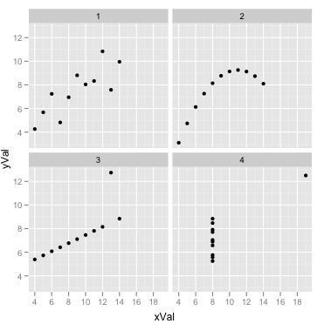
Which has the highest correl.?
This is called Anscombe’s Quartet
Notes:
Another example that many students find both surprising and informative. This one generated a lot of great discussion among attendees!
All have the same correlation coefficient! (.82)

Slide 22
Argue about these:
An actual article said something like: there is a link between credit card debt and health problems. So, to make yourself healthier, pay down your credit cards, since credit card debt causes stress which can cause health problems.
Debt and health problems: maybe health problems cause debt, more than debt causes health problems?
Notes:
We went over some conclusions that were made based on regression results and correlation, then discussed what was wrong with the conclusions. These included lurking variables. Again, attendees enjoyed discussing the conclusions and trying to identify what the lurking variable might be, based on background knowledge. This was helpful in thinking about statistics as a tool for research, and not a bunch of ideas that exist in a vacuum.

Slide 23
True or False?
If you live in a district with a $50,000 average and move to a district with a $60,000 average, that district’s score will be 59 points higher.
False; your child is still your child with all their existing demographics. While an increase might happen, there’s no reason to think it would even average 59 points.
Notes:
We also did true/false regression model conclusions that covered interpretation concepts such as “correlation does not imply causation” and avoiding making too strong of a statement ‘ ideas like “on average” are important - statistics aren’t deterministic!

Slide 24
30 mins
GAISE activities part 1: participants engage in activities that teach the standard through the GAISE process, then debrief on the experience and how to utilize the activity in their own classroom
Possible / Favorite activities for Quantitative Association:
M&M Exponential Survival Curve
Barbie Bungee
Spaghetti Bridge
Balloon Descent Time
Paper Helicopter Descent Time
Sports ball bounce height (Golf? Ping-pong? Superbounce?)
Two Estimates of Timing, or weight of objects, or age of a person
Notes:
We allowed groups to pick a hands-on activity and present their findings to everyone. They covered many of the core standards, such as informal inference and fit.
Nice to show all activities in the list but make one bigger/colored font and only carry that one through a just a little more detail (or here you might not really talk about these at all, just mention they were great and got group moving

Slide 25
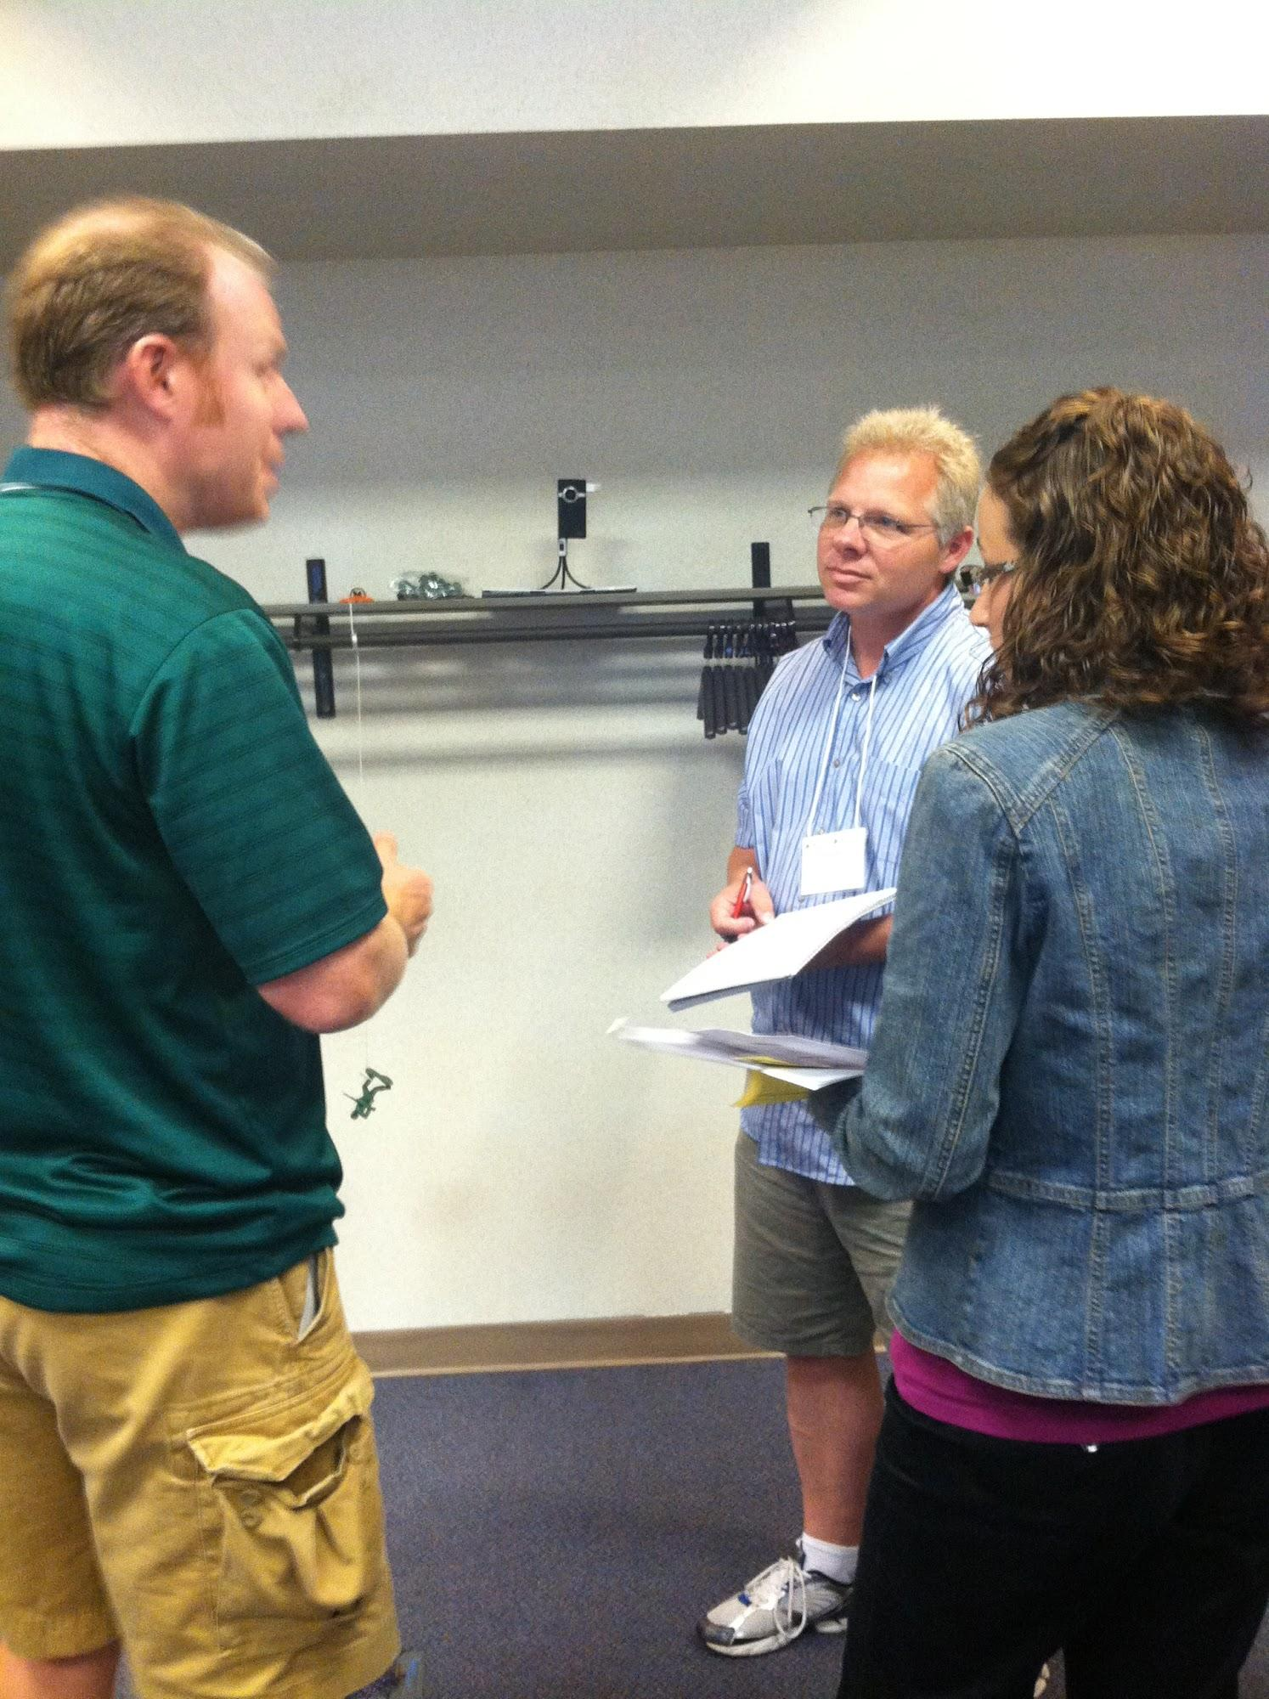
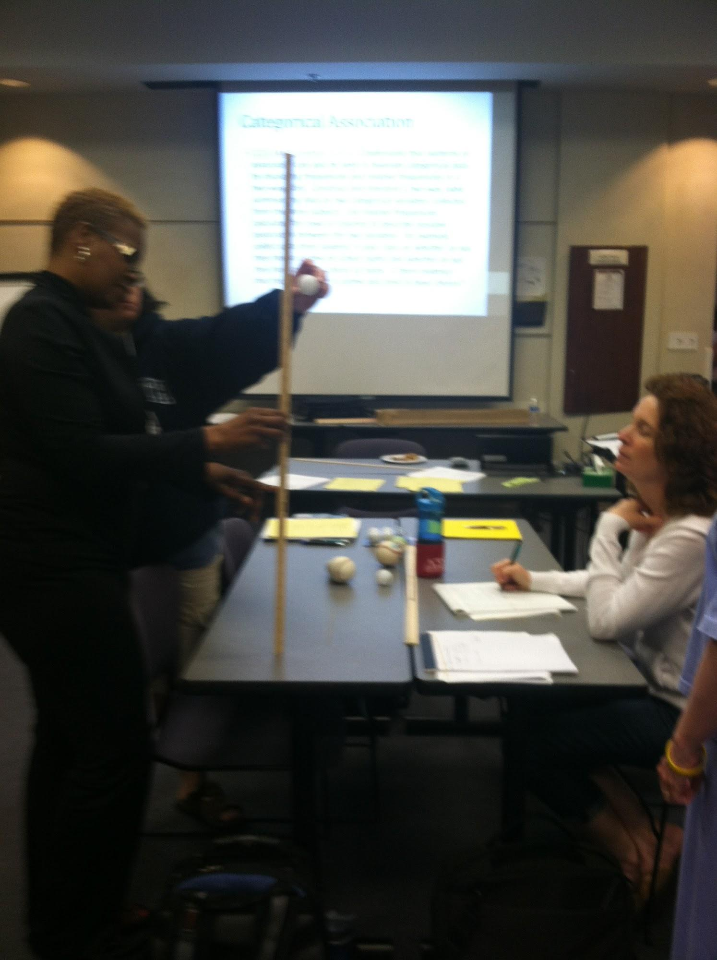
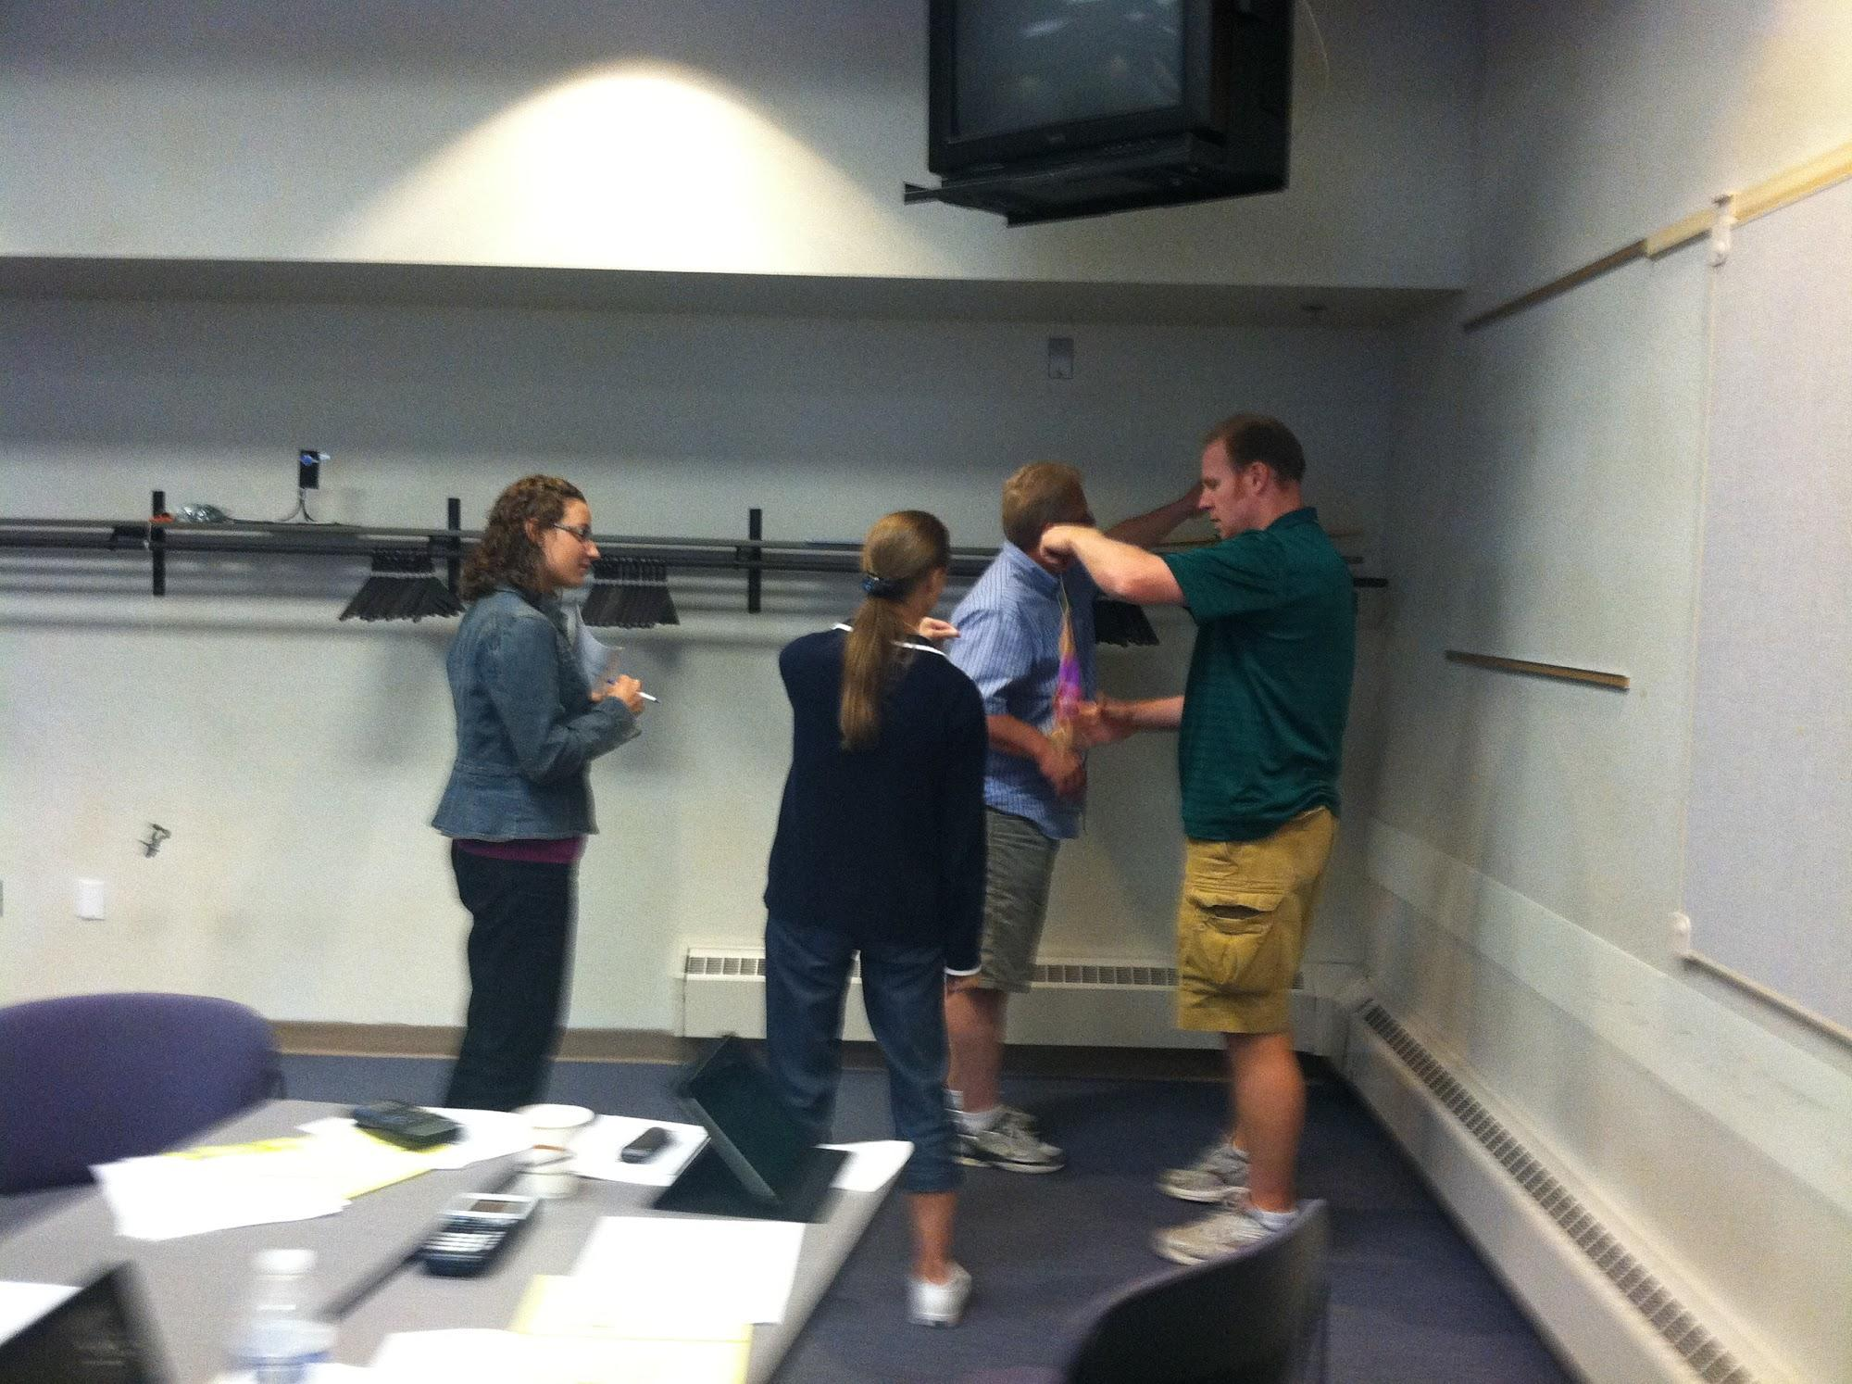
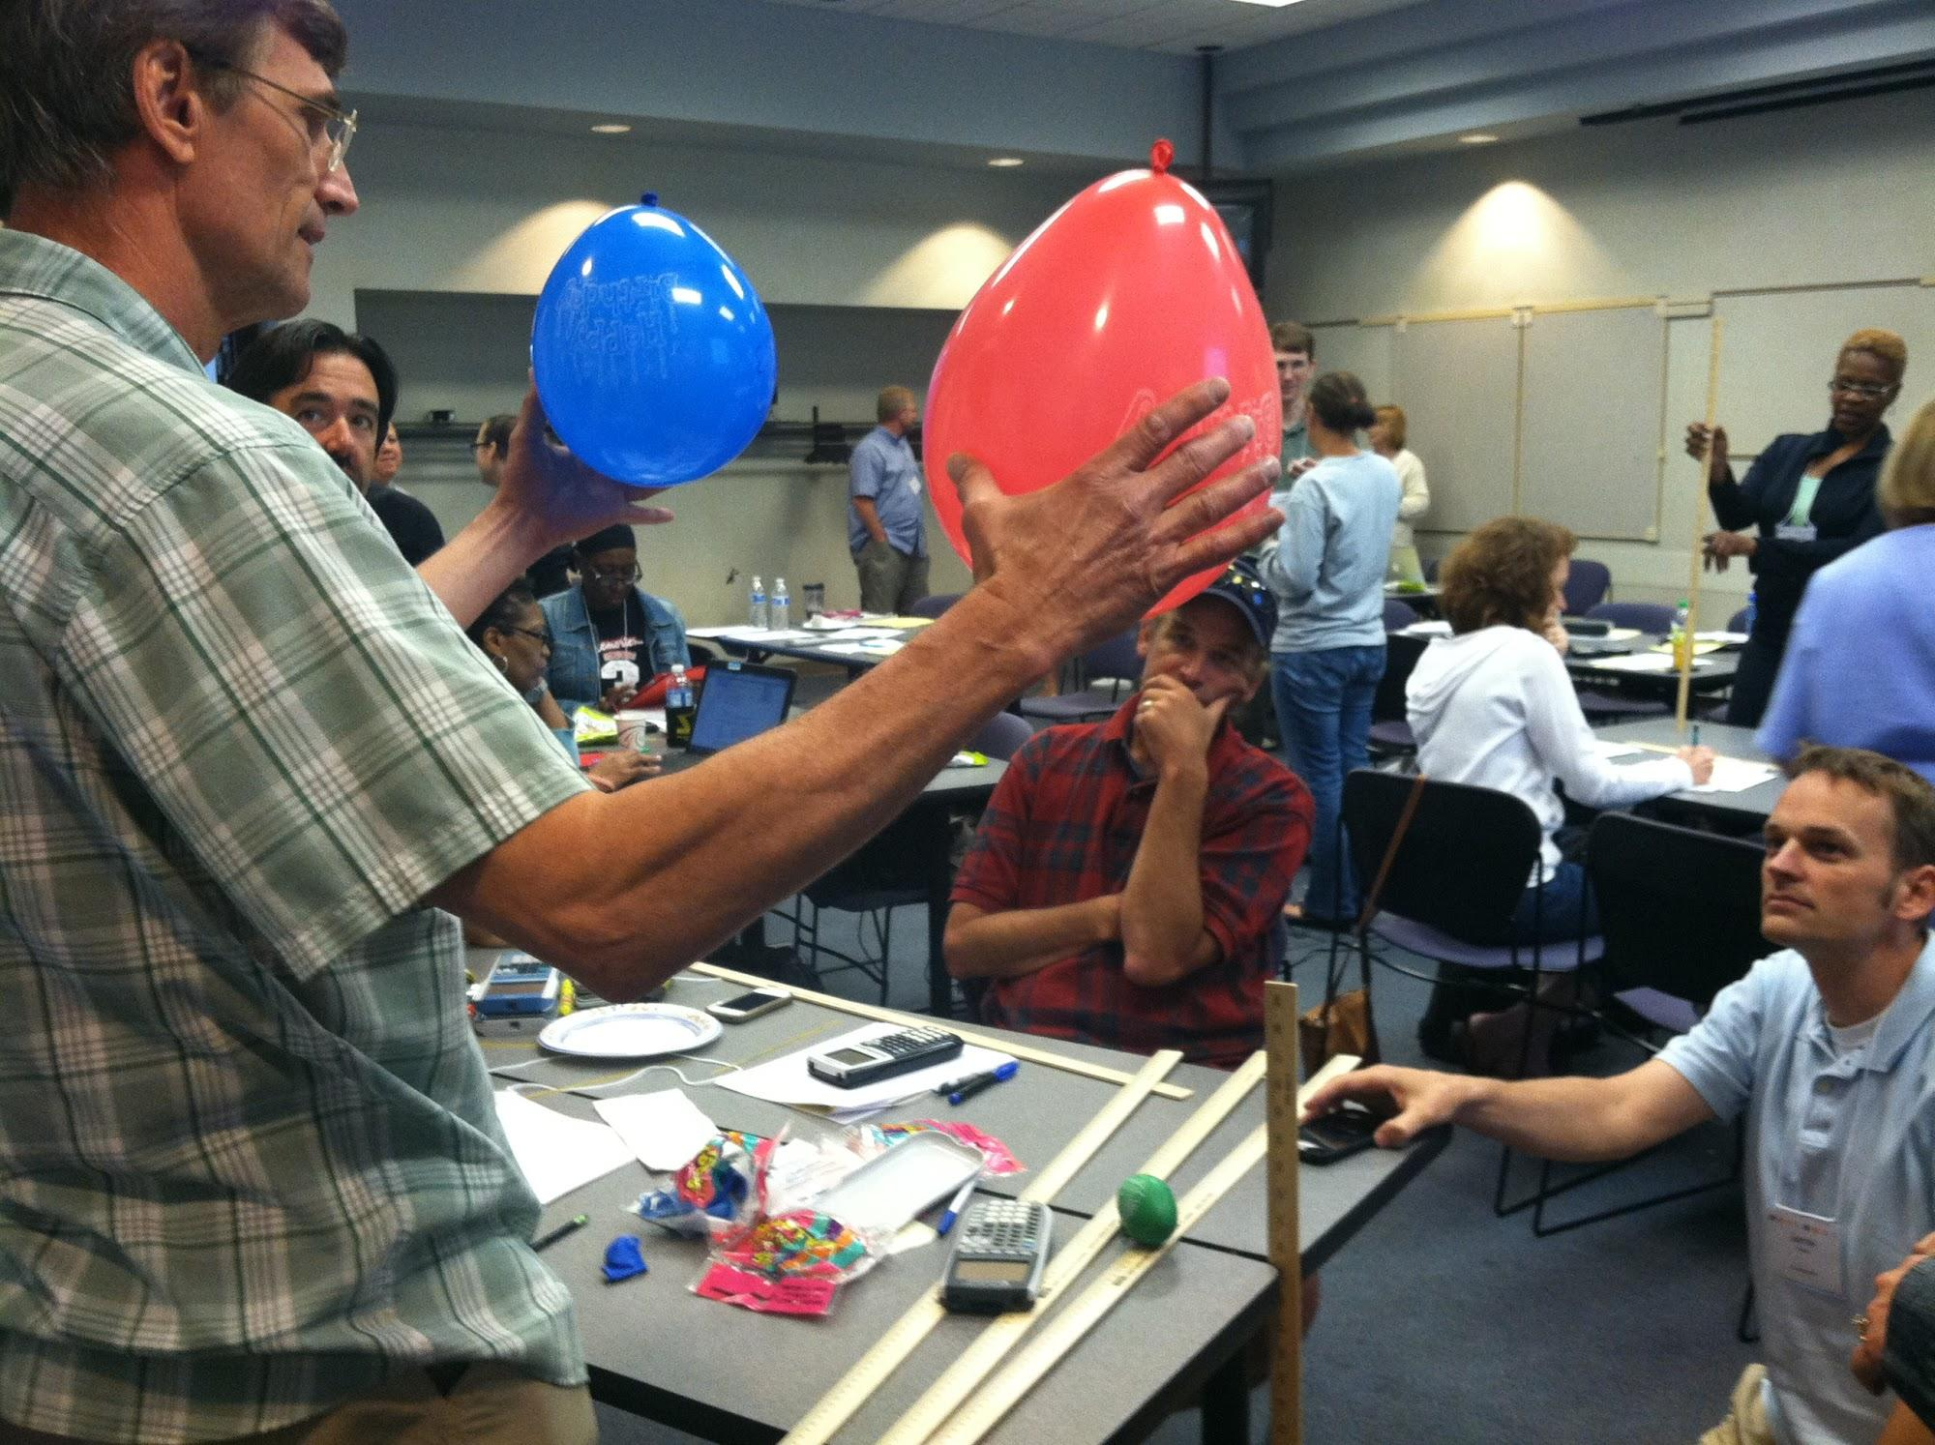
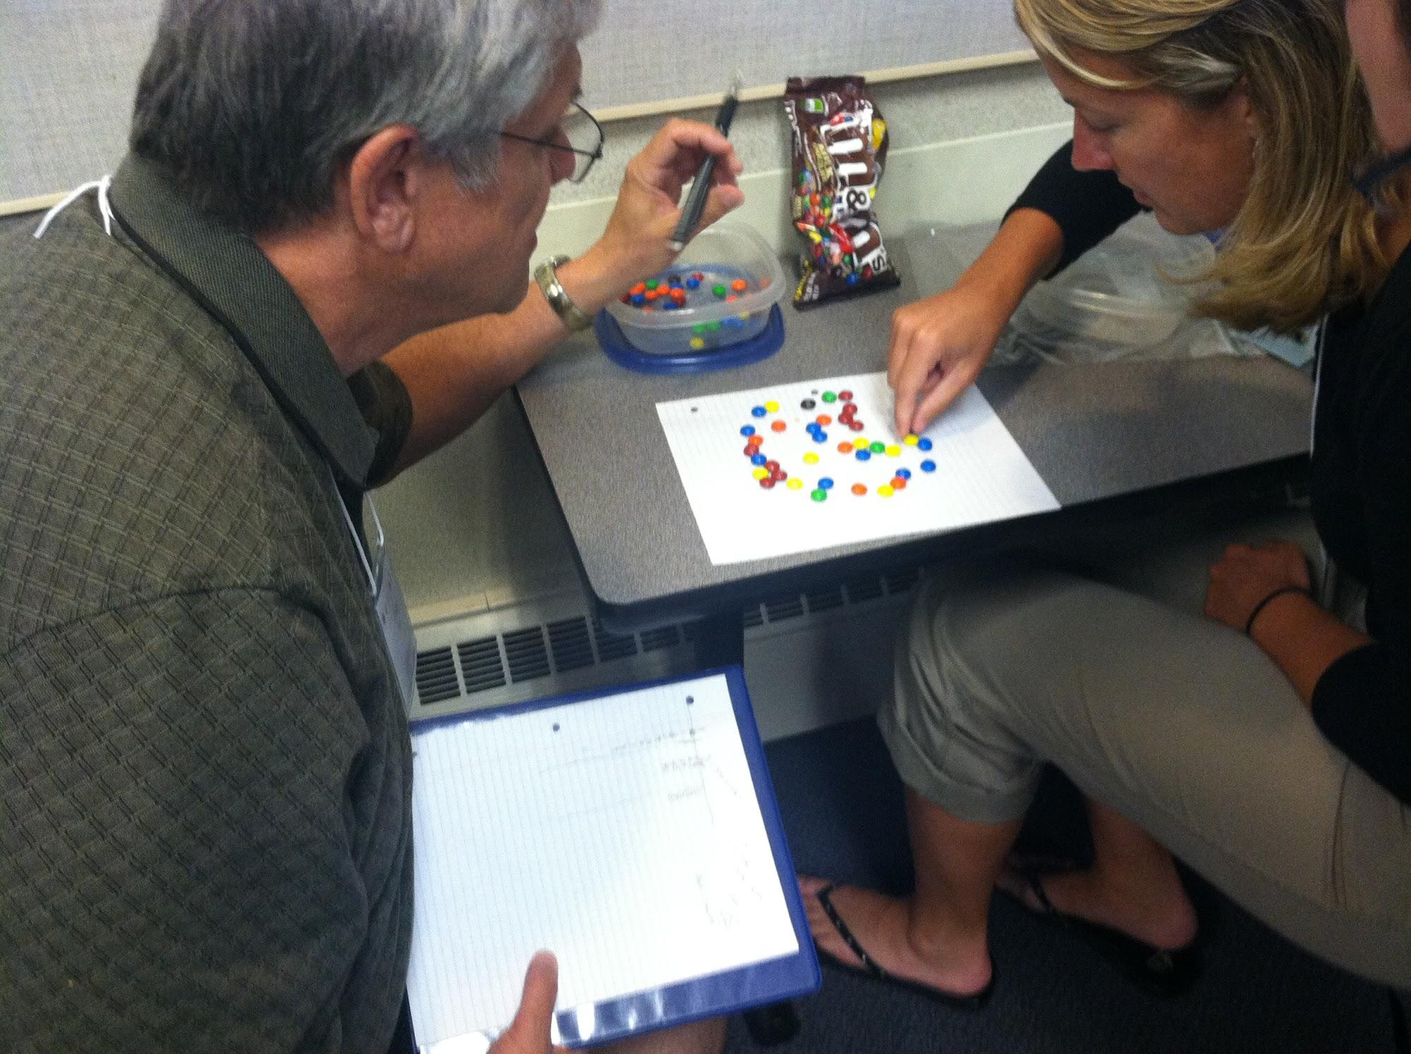

Slide 26
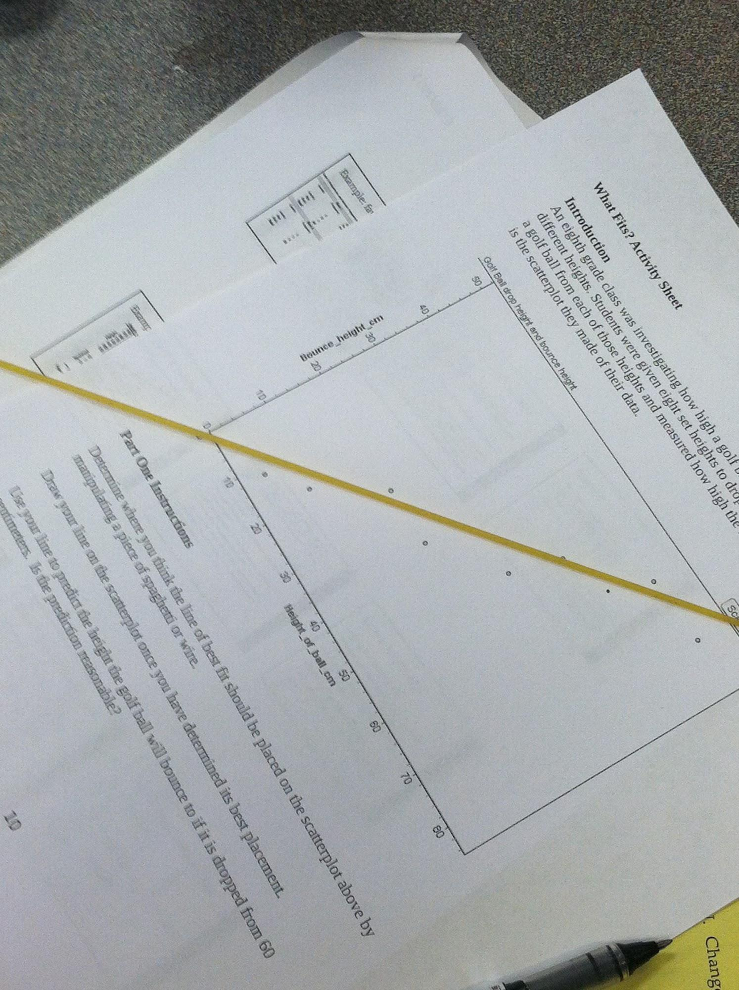
Informal Fit
Using Golf Ball Drop data
Use spaghetti to show your informally fitted line.
Not allowed to break spaghetti to connect individual dots!
Notes:
In this activity, we involved something tangible - dry spaghetti - to emphasize the idea of (linear) informal fit. Next, we present some of the common ideas students have for what a best-fit line should be, and then we try to diagnose some student responses for this data.
Advice about not breaking spaghetti came from the NSA balloon drop activity, “Take A Breath”:
http://www.nsa.gov/academia/_files/collected_learning/high_school/statistics/take_a_breath.pdf

Slide 27
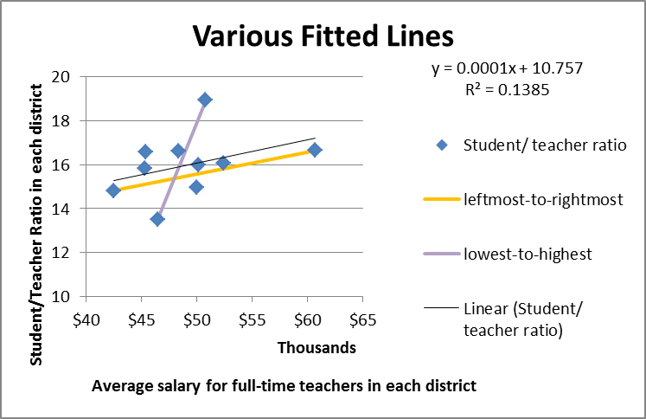
Common suggestions for informal fits:
Notes:
We also presented examples of common student ideas/mistakes for fitting a line to data.

Slide 28
Common student conceptions
The following graphs show where actual students placed a “best-fit” line (thin metal rod) on Golf Ball Drop data
For each, try to figure out the student's reasoning; then we'll reveal it.
Notes:
Again, common questions and misconceptions are great to anticipate, and sometimes it’s hard to know what students are thinking based on the work they turn in, so we tried to “troubleshoot” some example student works.

Slide 29
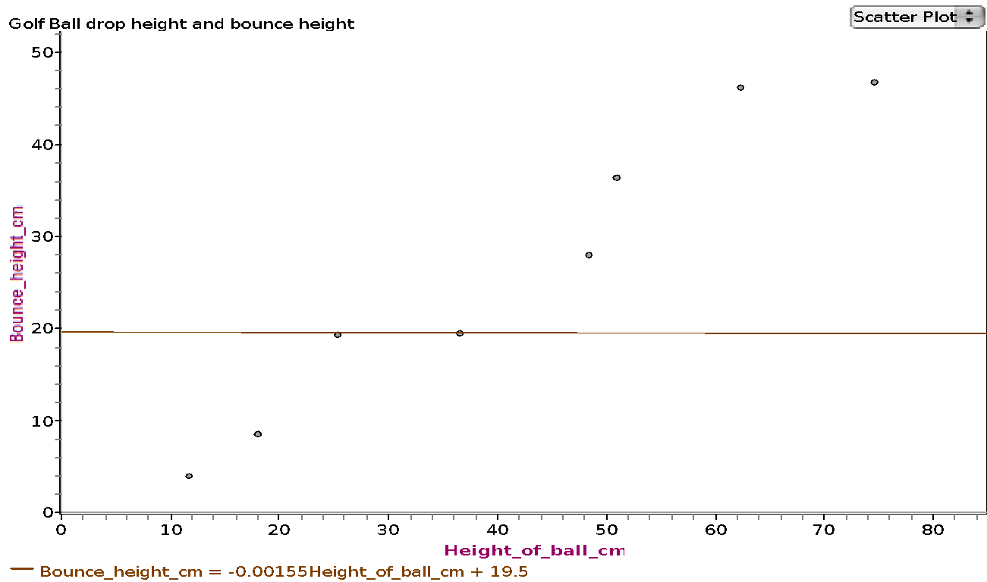
I thought of the line of best fit like the mode, so I put the line through two points with the same y-coordinate because they occur most often.

Slide 30
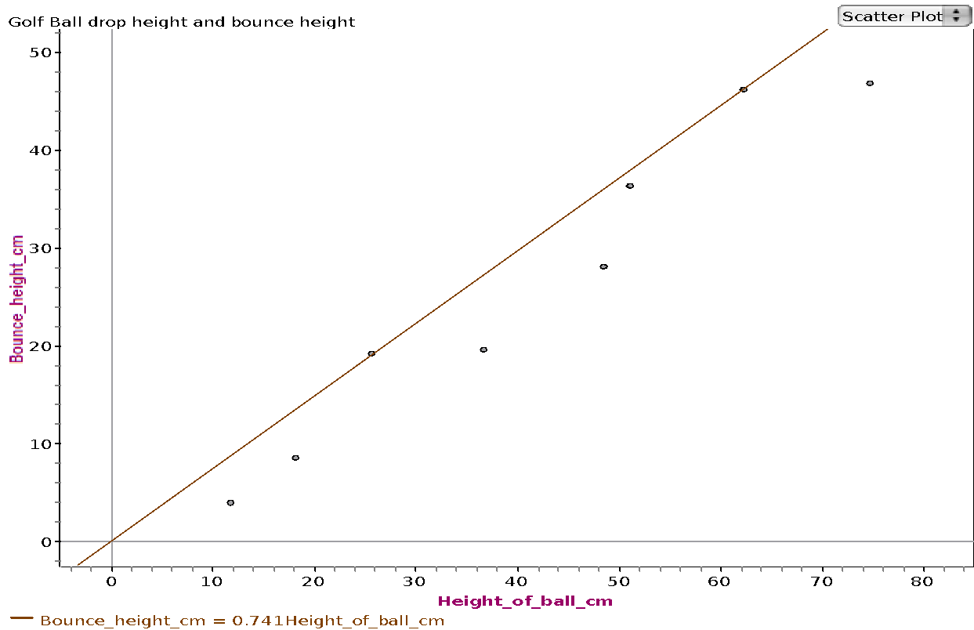
The line needs to start at (0,0) then go through the most dots. I got my line to go through two of the dots so I put it there.

Slide 31
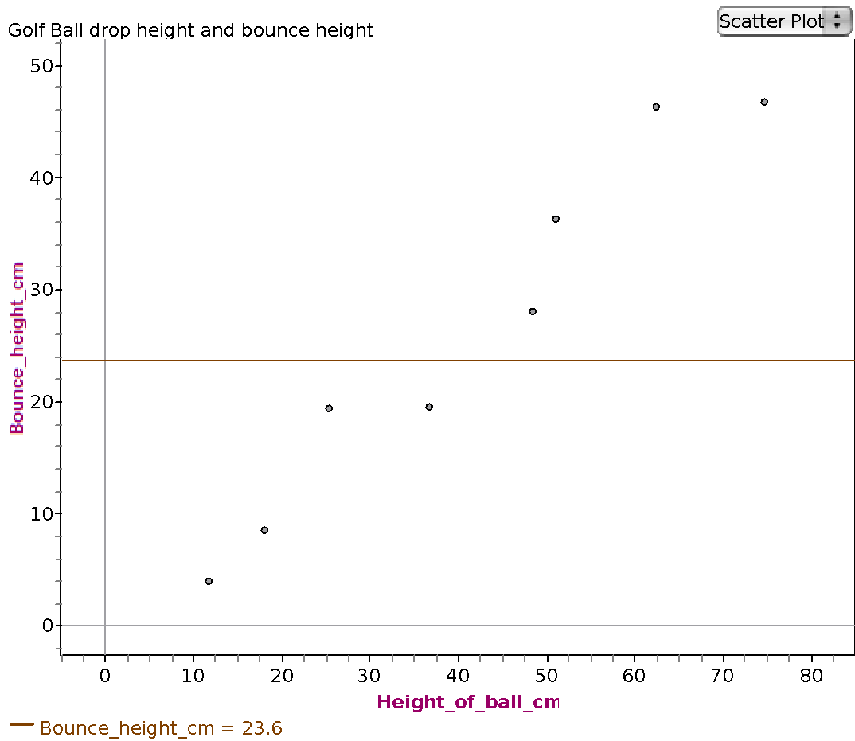
The line should be in the middle of the highest and lowest points because that’s like the average.

Slide 32
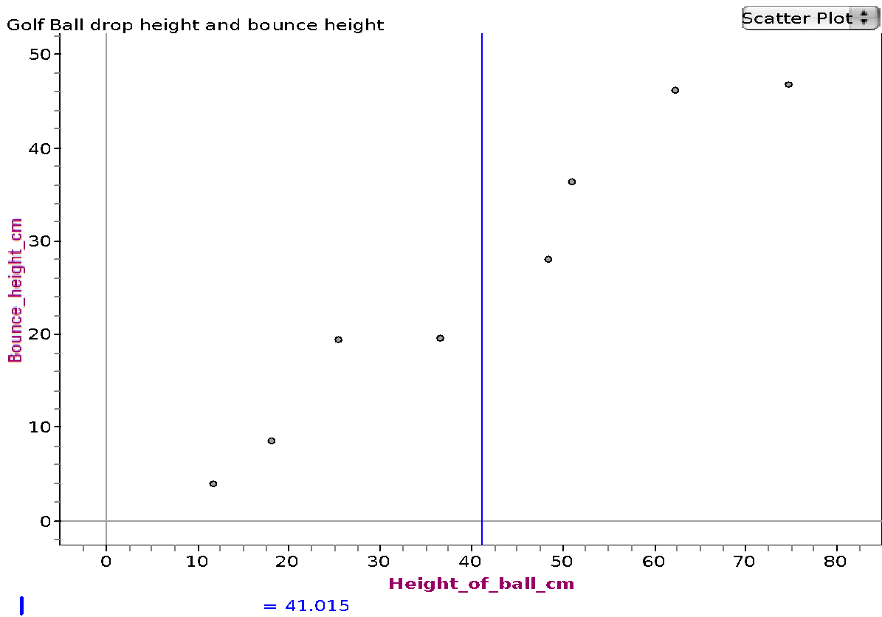
I know the line should go in the middle of the data. I put it here so it would be in the middle, four points on each side.

Slide 33
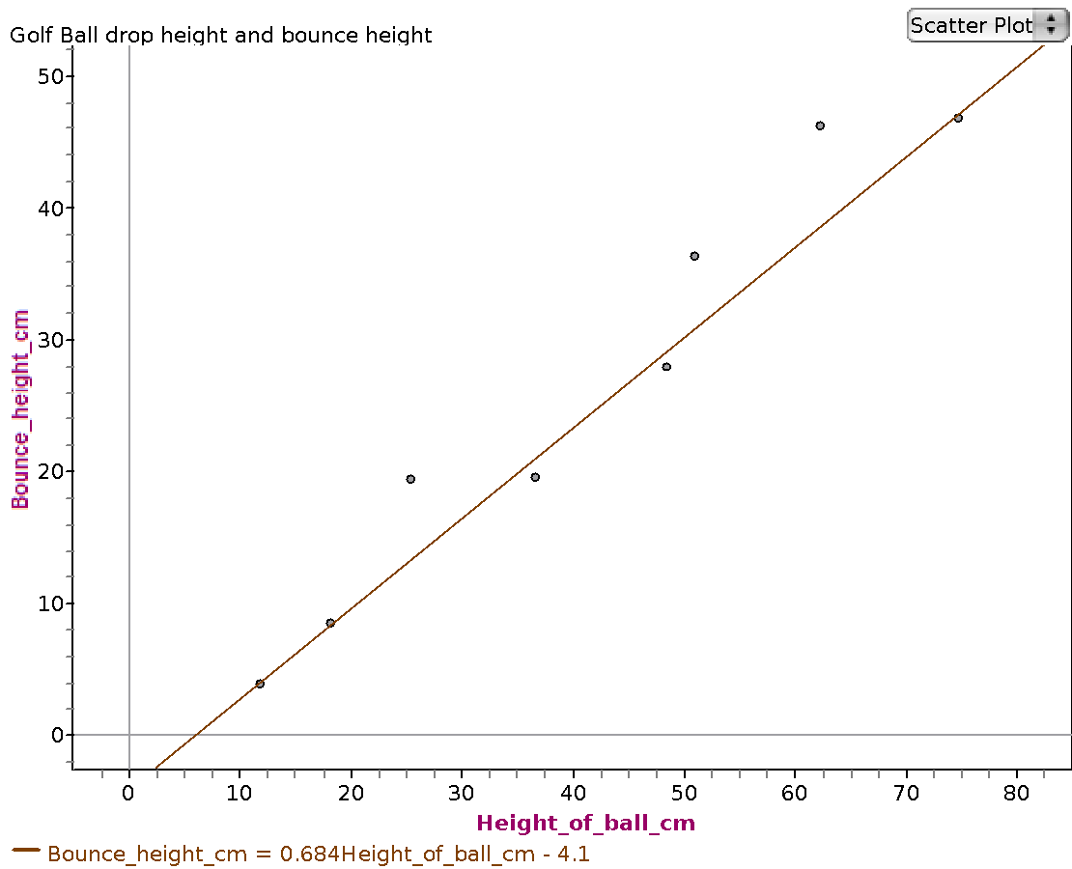
I tried to make my line go through the most dots.

Slide 34
Day 3: Sampling Distributions

Slide 35
CCSS.Math.Content.HSS-IC.A.1
Understand statistics as a process for making inferences about population parameters based on a random sample from that population.
CSS.Math.Content.7.SP.A.1
Understand that statistics can be used to gain information about a population by examining a sample of the population; generalizations about a population from a sample are valid only if the sample is representative of that population. Understand that random sampling tends to produce representative samples and support valid inferences.

Slide 36
Simulation approach to sampling distributions
Hands-on simulations still valuable for first experiences
Suggested learning process:
1) Student makes predictions
2) Student observes what really happens
3) Discuss difference between the prediction and actual empirical results
Student forced to address misconceptions if prediction turns out to be false
Notes:
We outlined a way to think about how students should experience statistics through simulation studies: predict, try it out, figure out what they got right and wrong and why.

Slide 37
Word memorization
In a moment, you will flip over the paper in front of you.
Take 30 seconds to look at the words on the paper and memorize as many words as you can.
After 30 seconds, you will be asked to flip the paper back over. On the back side of the paper, write down the words that you remember.
Ready, go!
Notes:
Here’s an example activity where two groups are compared.

Slide 38
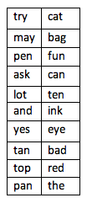

Group 1
Group 2

Slide 39
How many words did you remember?
The people in this room were randomly assigned to two groups.
One group had nonsense words, and the other group had real words.
Do you think one group could memorize more than the other group?

Slide 40
Are the results statistically significant?
Let’s begin by assuming that the treatment –given a list of nonsense words vs given a list of meaningful words – does not make a difference in number of words memorized.
If we calculate the mean for the two groups, what should the difference be?
Is it still possible that we could see a difference in mean number of words memorized?
Notes:
we introduced hypothesis testing informally

Slide 41
It’s the job of a statistician to decide if the results from a study are statistically significant or simply due to random chance.
In other words, if the two groups actually memorize the same number of words on average, how often would we see a sample with a difference in means of _______?
Is it very likely, somewhat likely, or very unlikely?
Notes:
and covered the idea that statistics aren’t definite.

Slide 42
To answer these questions, we will use simulation
First we will write each datum on a separate card.
We are going to assume that the two groups are actually the same. If they are the same, it won’t matter if we mix the two groups together.
Now we will draw two random groups from the data, of the same sizes as the original data.
For example, if the original data had one group of 12 and another group of 18, then your two random groups should have size 12 and 18.
Take the average number of words memorized from each group and calculate the difference, always subtracting in the same order (e.g. mean of size-12 group minus mean of size-18 group)
Record your answer. Repeat this process ten times.
Notes:
and then suggested a simulation approach to answering the research question and doing the hypothesis test.

Slide 43
Sampling Distribution
Have a representative from each group come up to the graph and record the differences that you’ve collected.

Slide 44
Sampling distribution
Our distribution shows the number of times that each difference was seen through our simulation assuming no difference between the two groups.
How often did you see a difference of ______ or greater?
If the groups are actually the same, we see a difference of _____ or greater only ______% of the time.

Slide 45
Conclusion
What conclusion could we draw?
There is no real difference between the treatments, and the researchers were unlucky in the random assignment to have found a difference of _________.
or
We are now convinced that there is a genuine effect from memorizing meaningful words instead of nonsense words?

Slide 46
Think about it…
Would our conclusion be the same if the difference between the two sample means were 2?
Why or why not?

Slide 47
Main Ideas:
We used random samples from two treatment groups to assess if the difference between two means was significant.
We assumed that there was no difference in means.
We combined our data from the two groups, randomly chose two new groups, and computed a difference in means.
Repeating the above procedure, we create a sampling distribution of the differences between the two means.
We used our sampling distribution to assess the likelihood of seeing a difference as large or larger than the one that we observed from our two samples.

Slide 48
Polling a city
An organization wants to know what percentage of homes in a city have pets. The organization polls homes randomly to answer this question:
Do you have a pet? Yes No
(Students can come up with their own questions)

Slide 49
Polling a City
One student believes that the true proportion of homes that have pets is 50%. She takes a sample of 50 people from her city. She gets a proportion of only 30%, which is far less than she predicted. Could the population proportion still be higher?
Take 1 minute to talk to a partner. Be ready to share.

Slide 50
Many random samples
She knows that a second random sample of 50 people may produce a different sample proportion. She wonders how much variation there might be among sample proportions of size 50, and what the true population proportion might be.

Slide 51
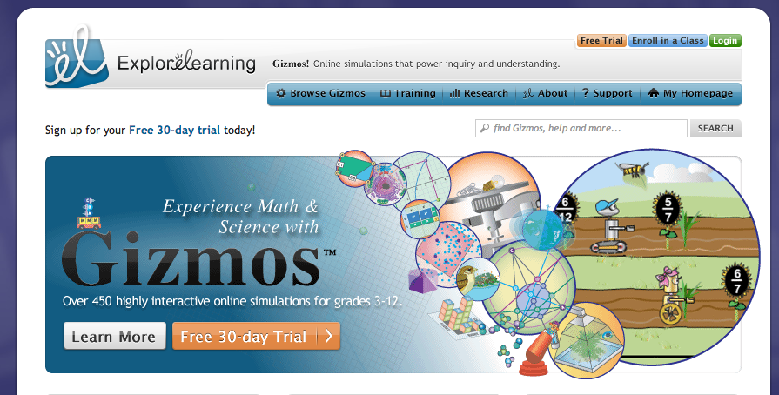
Explorelearning.com

Slide 52
Middle School Activity
Let’s make a sampling distribution for the sample proportions collected in our city.
This will allow us to see the variation of sample proportions from the population proportion
Each group will take 10 samples of 50 people using the Polling: City Gizmo.
How much variation do you see in your data? What could the true population proportion of yeses be?

Slide 53
High School Activity
We want to know the mean number of times per week that people access the facebook homepage.
Using simulation, we will take many random samples of 25 from our population and calculate the sample mean.
http://onlinestatbook.com/stat_sim/sampling_dist/
Create a histogram of our sample means to create a sampling distribution.
What is the shape of the sampling distribution? Mean? Standard Deviation?

Slide 54

Keys to success of seminar
Pre-seminar survey
CCSS-M centered
Dynamic instructors
Interesting, interactive activities tied to GAISE

Slide 55
Keys to changing instruction following seminar
Encouraged professional relationships by having participants sit at tables and working together
Creation of a website where we put all of our materials for download, as well as links to relevant documents (e.g., GAISE, CCSS-M progressions documents) and websites (e.g., STEW, applets)

Slide 56
Thanks for attending our webinar!
Contact information:
Stephanie Casey scasey1@emich.edu
Karen Nielsen karenen@umich.edu

