Slide 1
Having Success with the
ASA
Statistical Project Competition
Dr. Jamis J. Perrett
Department of Statistics
Texas A&M University
Sarah Johnson
Mathematics Department
Grand Blanc High School

Slide 2
Description
Statistical Project Competition
Sponsored by ASA/NCTM
Available to all students, grades 7-9 and 10-12
Prizes include money, plaques, certificates, TI calculators

Slide 3
What is a Statistical Project?
“A statistical project is the process of answering a research question using statistical techniques and presenting the work in a written report. The research question may arise from any field of scientific endeavor, such as athletics, advertising, aerodynamics, or nutrition.”
(http://www.amstat.org/education/posterprojects/whatisastatproject.cfm)

Slide 4
What is a Statistical Project?
The Scientific Method in Practice
Ask a question about the world around you.
Design a method to collect data to answer that question.
Summarize the data using summary statistics.
Analyze the data.
Make a conclusion that answers your initial question.
Reflect on the process.
Then, you and your group write up your findings in a written report, averaging about 5-10 pages.

Slide 5
Purpose
Provide students with a culminating statistics project that combines and puts into practice the tools they have learned.
Motivate students to use the statistics that they have learned in their classes.

Slide 6
Who can participate
Grades 7-12 students who have not won previously in their current grade category (7-9 and 10-12).
Each entry can have up to 4 students with the oldest student determining the grade category.
Due date is June 1.
  AP Statistics Exam: May 16, 2012
  AP Statistics Reading: June 10-16, 2012

Slide 7
List of Topics
Potential topics include…
Tables and Graphics
Descriptive Statistics
Basic Sampling Methods
Designed experiments:
  Completely Random Designs
  Block Designs
Basic Probability
Confidence Intervals for Means or Proportions
Hypothesis Tests:
  One- and Two-sample T-tests
  Randomization Tests
  Chi-square Tests
  Correlation and Regression Coefficient Tests
  One- or Two-factor ANOVA

Slide 8
Important Rules
The project needs to be a statistical study: collect data to assess a hypothesis.
Submissions that go beyond 2-factor ANOVA will not be judged.
Projects submitted after June 1 will not be judged.
Project reports must be submitted in PDF format.

Slide 9
The Prizes
Prizes are awarded in both age groups
  1st place: $200, Certificate, and Plaque for school
  2nd place: $100 and Certificate
  3rd place: $50 and Certificate
  Honorable mention: Certificate and Ribbon
Additionally, through the generous support of Texas Instrument, 1st place winners and their advisors will be awarded graphing calculators.

Slide 10
Judging
There are two rounds
First round: Every project judged by Grades 6-12 teacher and a statistician.
Second round: Top10 projects are judged by a statistician.
Overall combined scores determine the winners in the two grade categories.

Slide 11
Rubric
The judges use a scoring rubric that looks at
  Question
  Research Design and Data Collection
  Analysis of Data and Conclusions
  Reflection on Process
  Final Presentation
  Creativity/Originality
The rubric is online and should be consulted by students before submitting their projects. (http://www.amstat.org/education/posterprojects/pdfs/ProjectJudgingRubric.pdf)

Slide 12
Important Considerations
Randomize.
Replicate.
Control extraneous variation.
Lots of additional helpful information can be found on the competition website: http://www.amstat.org/education → K-12 → Student Competitions

Slide 13
Grading for This Class
50 points for proposal (on time)
100 points for Research Design and Data Collection
100 points for Analysis of Data and Conclusions
100 points for Reflection on Process
50 Points for Creativity / Originality
50 Points for Assembly (looks nice, cover page, etc.)
Final Exam - Presentation (power point)

Slide 14
AP Statistics Final Exam (Presentation)
Your group presentation is your final exam grade (20% of semester 2 grade), so please take it seriously. The construction of the power point presentation should be easy---you are dumping pertinent information from your paper to slides.
Each group member must dress professionally (shorts, jeans, flip-flops, t-shirts are not professional dress).
All group members must participate in the presentation.
All group members must be present BOTH days of presentations – your participation as an audience member is a part of your grade. (Tuesday and Exam Day).

Slide 15
AP Statistics Final Exam (Presentation)
BORING presentations will be marked down.
Things that are NOT considered boring include: pictures, charts, graphs, visual aids, inference stuff, stats, snacks for the class, etc.
Presentations should:
  State the question
  Tell us how you carried out the study (think photos here)
  Tell us what you found for results (think charts and graphs here)
  Answer your question
  Keep the senioritis-ridden audience’s attention.

Slide 16
AP Statistics Final Exam (Presentation)
I have invited various administrators to view your presentations…you never know who will show up!
If you have questions……PLEASE ASK!!!
See Mrs. Johnson to sign up for a presentation time ASAP!

Slide 18
2nd Place 2011 Team
Selected a topic that interested them, and had a lot of FUN collecting the data.
Project was titled “Battle of the Genders: Dance Edition”. Two of the three girls on this team have studied dance for over 13 years each.
Write up was only 5 pages in length (not including raw data). Concise.
They needed help with technical issues the most (i.e. how to insert a graphic from the TI-83, how to use the archaic version of equation editor we have at our school, etc.)

Slide 19
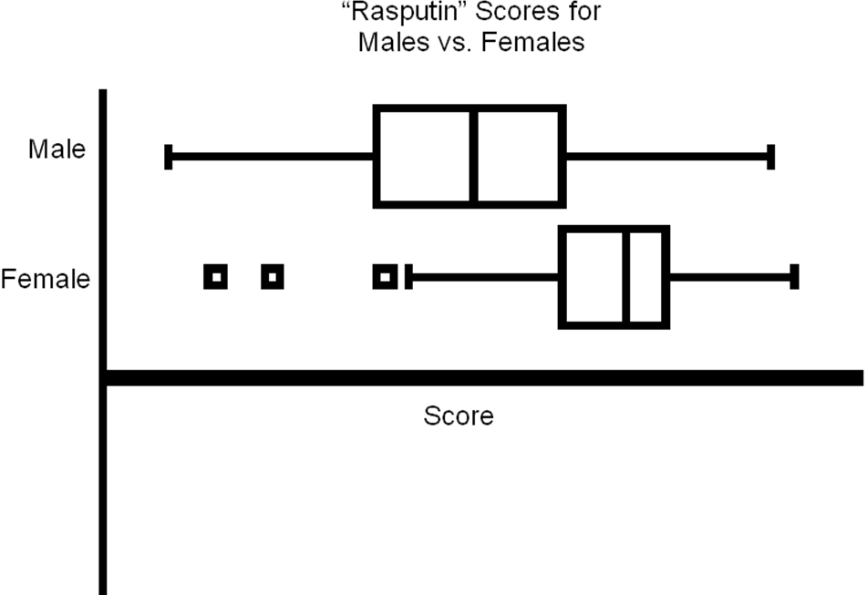
p-value=0.0000109
α=.01

Slide 20
Honorable Mention 2011
“Ye old windbags” (13 pages with raw data and very spaced out graphs)
Student was a cross country and track runner and had always thought that aerobic athletes had better lung capacities (though he was careful not to imply causation).
His interest level in his question drove this project to greatness.
He needed very little help, but SHOULD have asked for guidance in a key area (see judges comments for 2011 for details) and I think his project could have won.

Slide 21
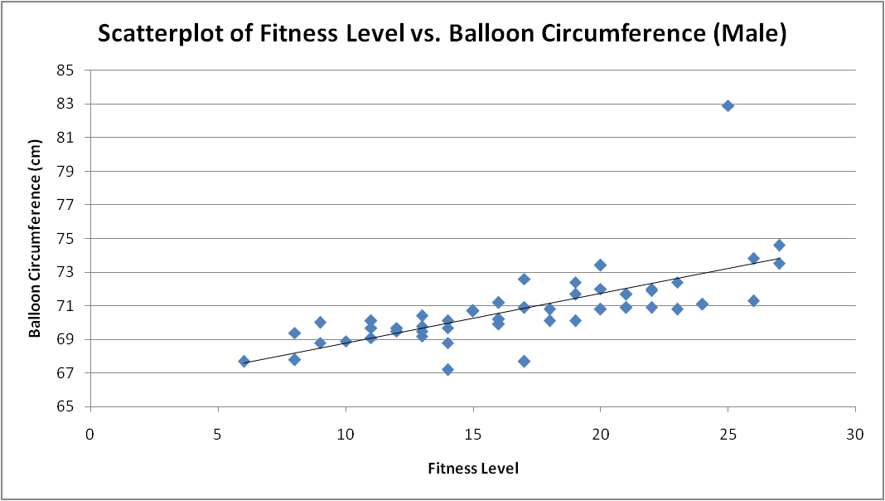
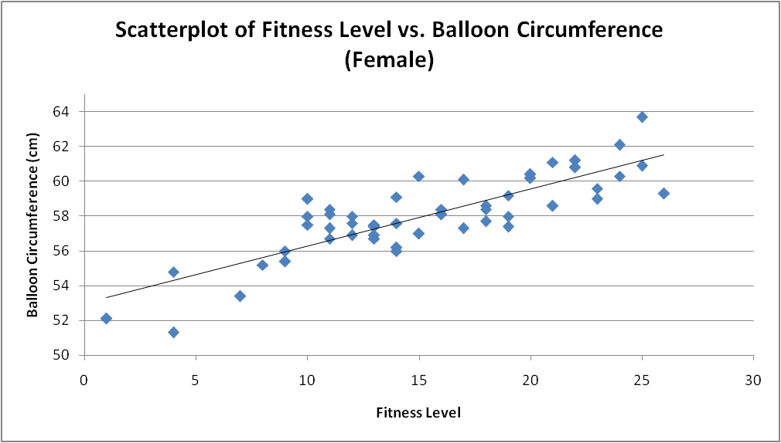
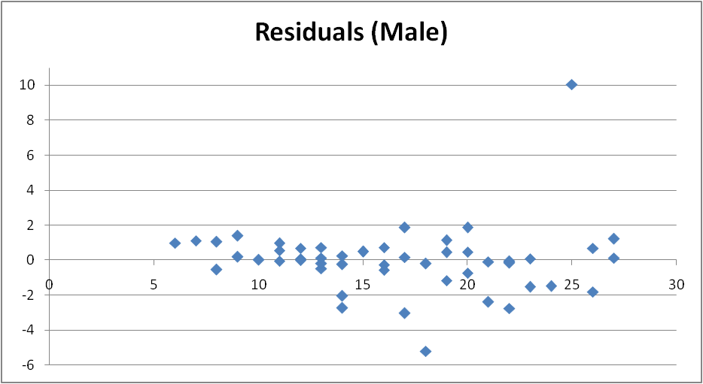
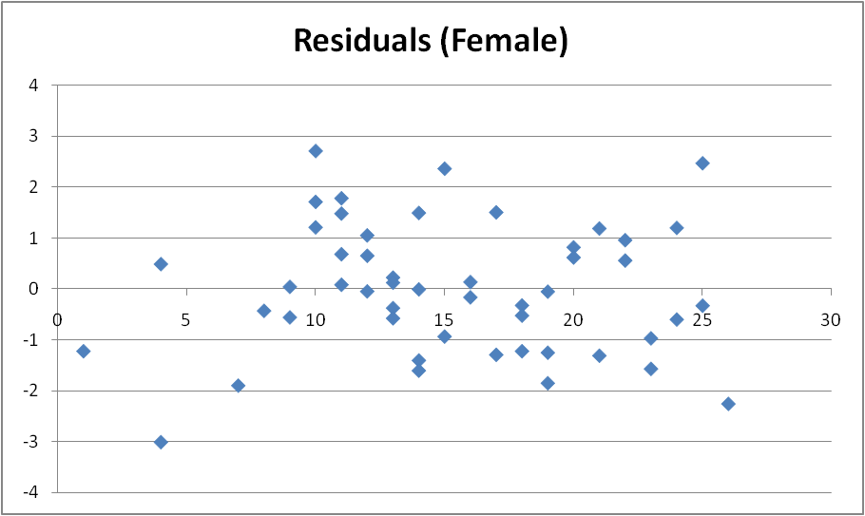
There is a positive, linear association between fitness level and balloon circumference for males. The only unusual point is the participant who got a balloon circumference of 82.9 with a fitness level of 25. Despite its notable y-value, the large numbers of data points make its effects on the slope of the regression line negligible, meaning it is an outlier but not an influential point. The correlation is moderate, with an r-value of .5992. For every single point increase in fitness level, balloon circumference increases by .2647cm.
There is a positive, linear association between fitness level and balloon circumference for females. It should be noted, however, that the values are considerably lower for females than males. The axes are not the same, simply scaled to show correlation better. There are no notable and/or influential points. The correlation is strong, with an r-value of .8357. For every single point increase in fitness level, balloon circumference increases by .3294cm.

Slide 22
Teacher Tips
Make sure you emphasize the importance of choosing group members wisely!
Allow students (groups) some time to struggle with their topic or question.
Feel free to VETO any question or topic you feel would provide issues for the group in the time frame.
VETO any project that is even remotely boring!!! They’ll thank you later!
Give them room to impress you!

Slide 23
QUESTIONS?

